Slide 1




OpenTURNS User Day #16
23 March 2023
Modeling the impact of atmospheric variables on the performance of an aircraft during take-off:
Towards the adaptation of air traffic operations to global warming
PhD student: Suzanne Salles⁽¹⁾⁽²⁾
⁽¹⁾ CECI, CERFACS/UMR5318 CNRS
⁽²⁾ DAEP, ISAE-SUPAERO,
Univ. of Toulouse
Directors: Sophie Ricci⁽¹⁾, Nicolas Gourdain⁽²⁾

Slide 2

Introduction

Slide 3

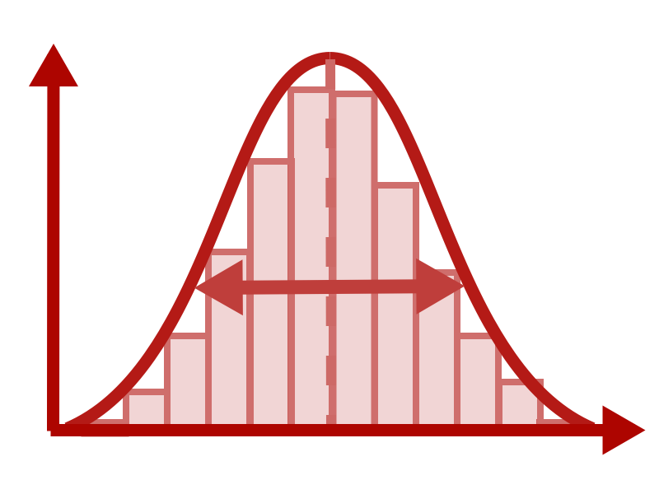
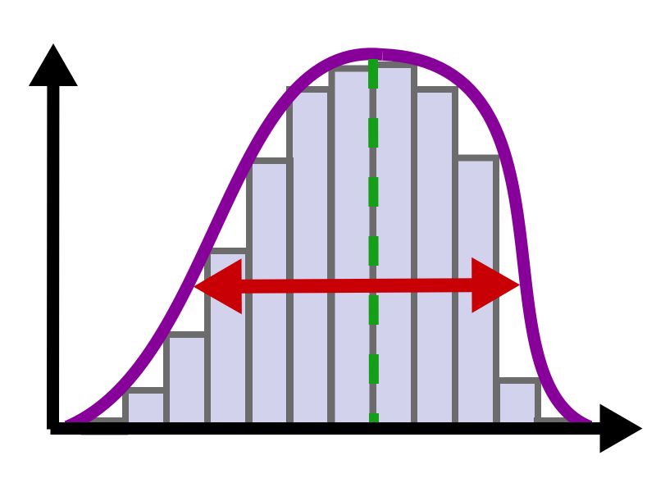
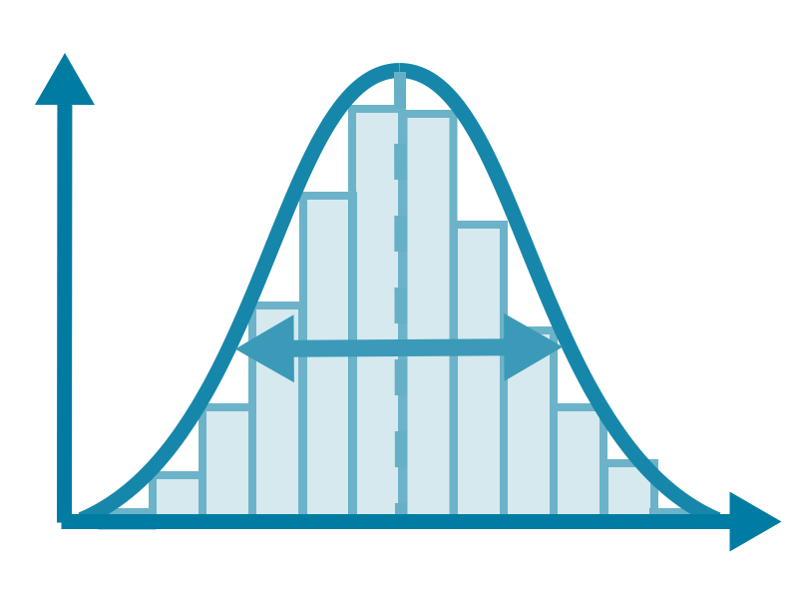
Context of the study
Aim:
Quantify the influence of atmospheric variables and their uncertainty on the take-off performance
Show that the model makes
T up hum up => MTOW down
Propagate inputs’ uncertainty to output
Compute estimations of sensitivity indices
How will atmospheric changes due to climate change affect aircraft performance during take-off in the future?
Workflow:
Atmospheric
variables
Aircraft performance Model
Take-off performance
Temperature
Humidity
Maximum take-off weight (MTOW)
→ Quantify the influence of atmospheric input variables on aircraft performance output
→ Quantify the sensitivity of performance to these variables
Uncertainty propagation
Sensitivity analysis:
Estimation of sensitivity indices
Uncertainty quantification:
Building an input distribution
Notes:
Propagating uncertainty on atmospheric variables to uncertainty on take-off performance variables through an aircraft model
From the distribution, sampling is done to propagate through model in order to characterize the distribution of the output
Sensitivity analysis :
Aim: Quantify which input has the most influence on the output uncertainty
Key issue: To compute sensitivity indices, the uncertainty on the inputs must be well quantified
Key issue : to compute sensitivity indices (whatever they are), you need to sample the input distribution with a sampling method adapted to the indice computation.
Need to build a probabilistic model of the joint input distribution.
How can we do this in the cse of dependent inputs ?

Slide 4
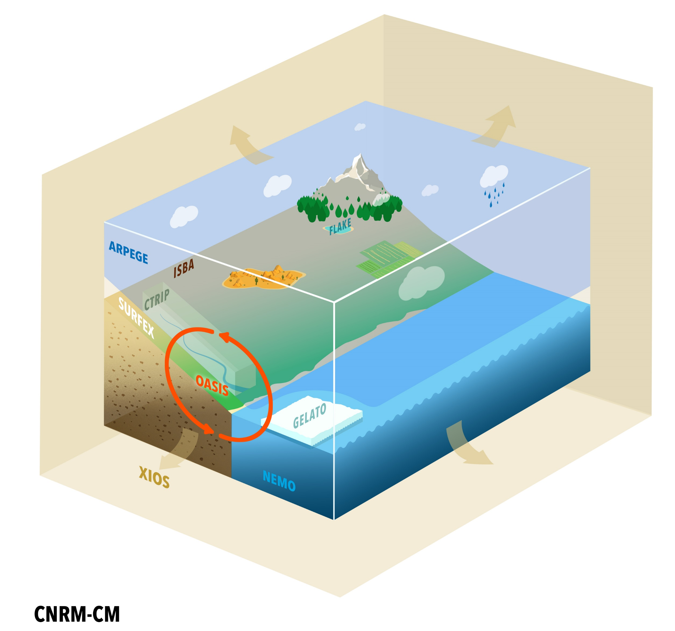
Should I show a graph of trends in the future? According to scenarios etc..
Input data
Variables
Huss: Daily mean specific humidity
Tasmax: Daily maximum temperature (K)
Specific humidity:
mass of water vapor
total mass of the air parcel
Future period:
2015-2100 (In this presentation: 2020-2050)
Localization:
Database of 13 airports around the world
4 different SSP (Shared Socio-economic Pathways) scenarios:
SSP1-2.6, SSP2-4.5, SSP3-7.0, and SSP5-8.5
Variables
Huss: Daily mean specific humidity
Tasmax: Daily maximum temperature (K)
Outputs of climate model: CNRM-CM6-1
Fully coupled atmosphere-ocean general circulation model
Developed by the CNRM/CERFACS modelling group for CMIP6 project [4]
Sources of uncertainty
Forcing
Model response
Internal variability
Image source: umr-cnrm
Notes:
The database used as inputs in my workflow are these two variables
Summer days defined as:
DEC-JAN-FEV for South hemisphere
JUN-JUL-AUG for North hemisphere
CMIP6: 6th Coupled Model Inter-comparison Project by the World Climate Research Program used for IPCC AR6 [ref]

Slide 5
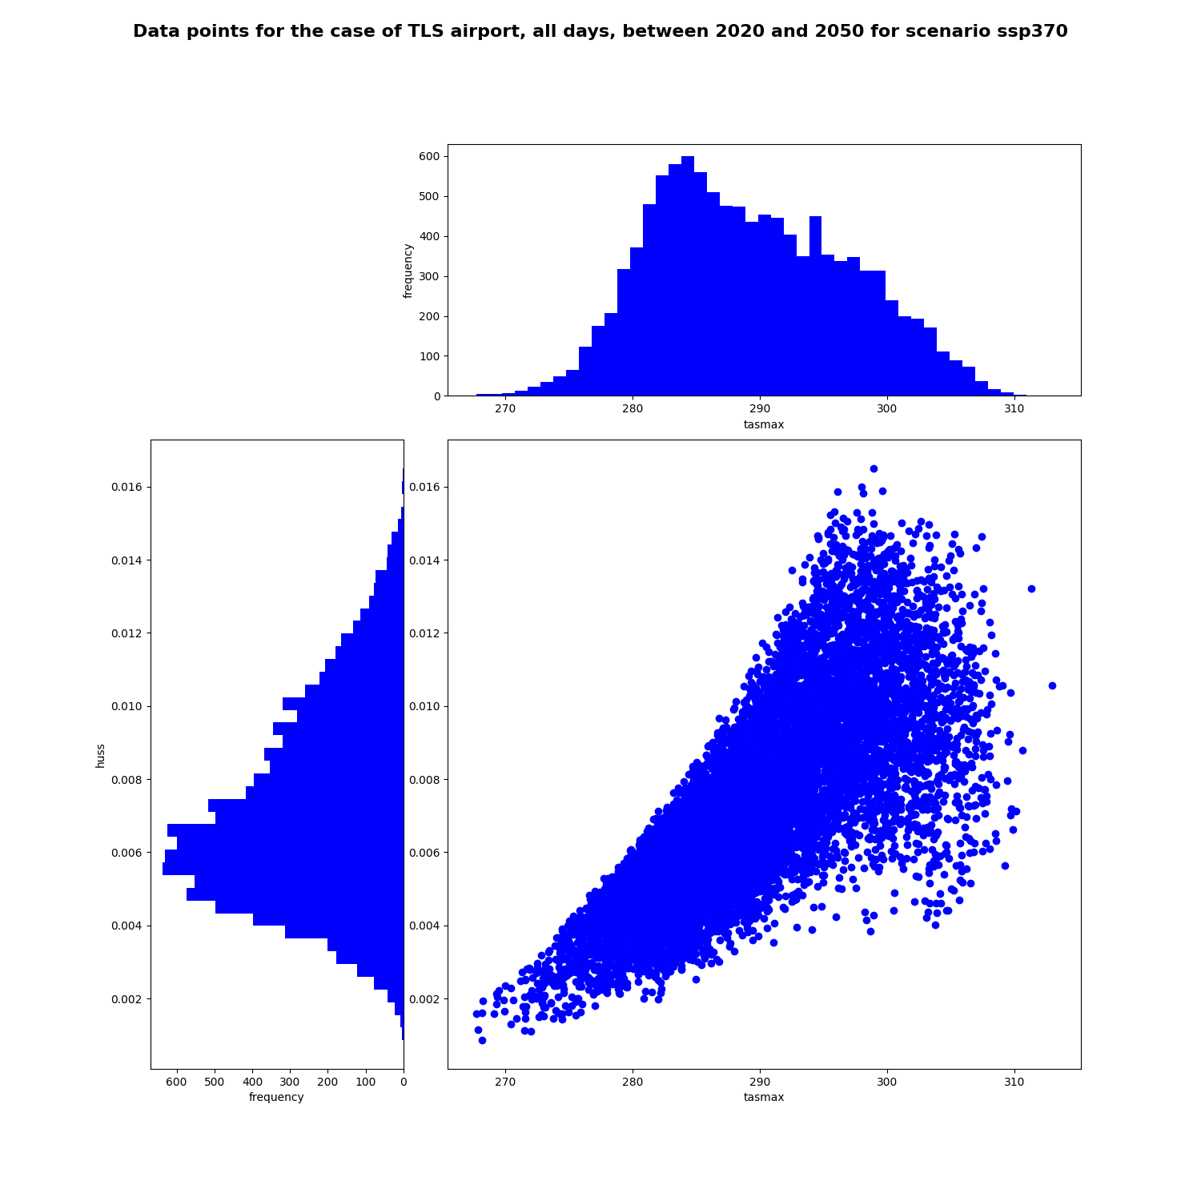
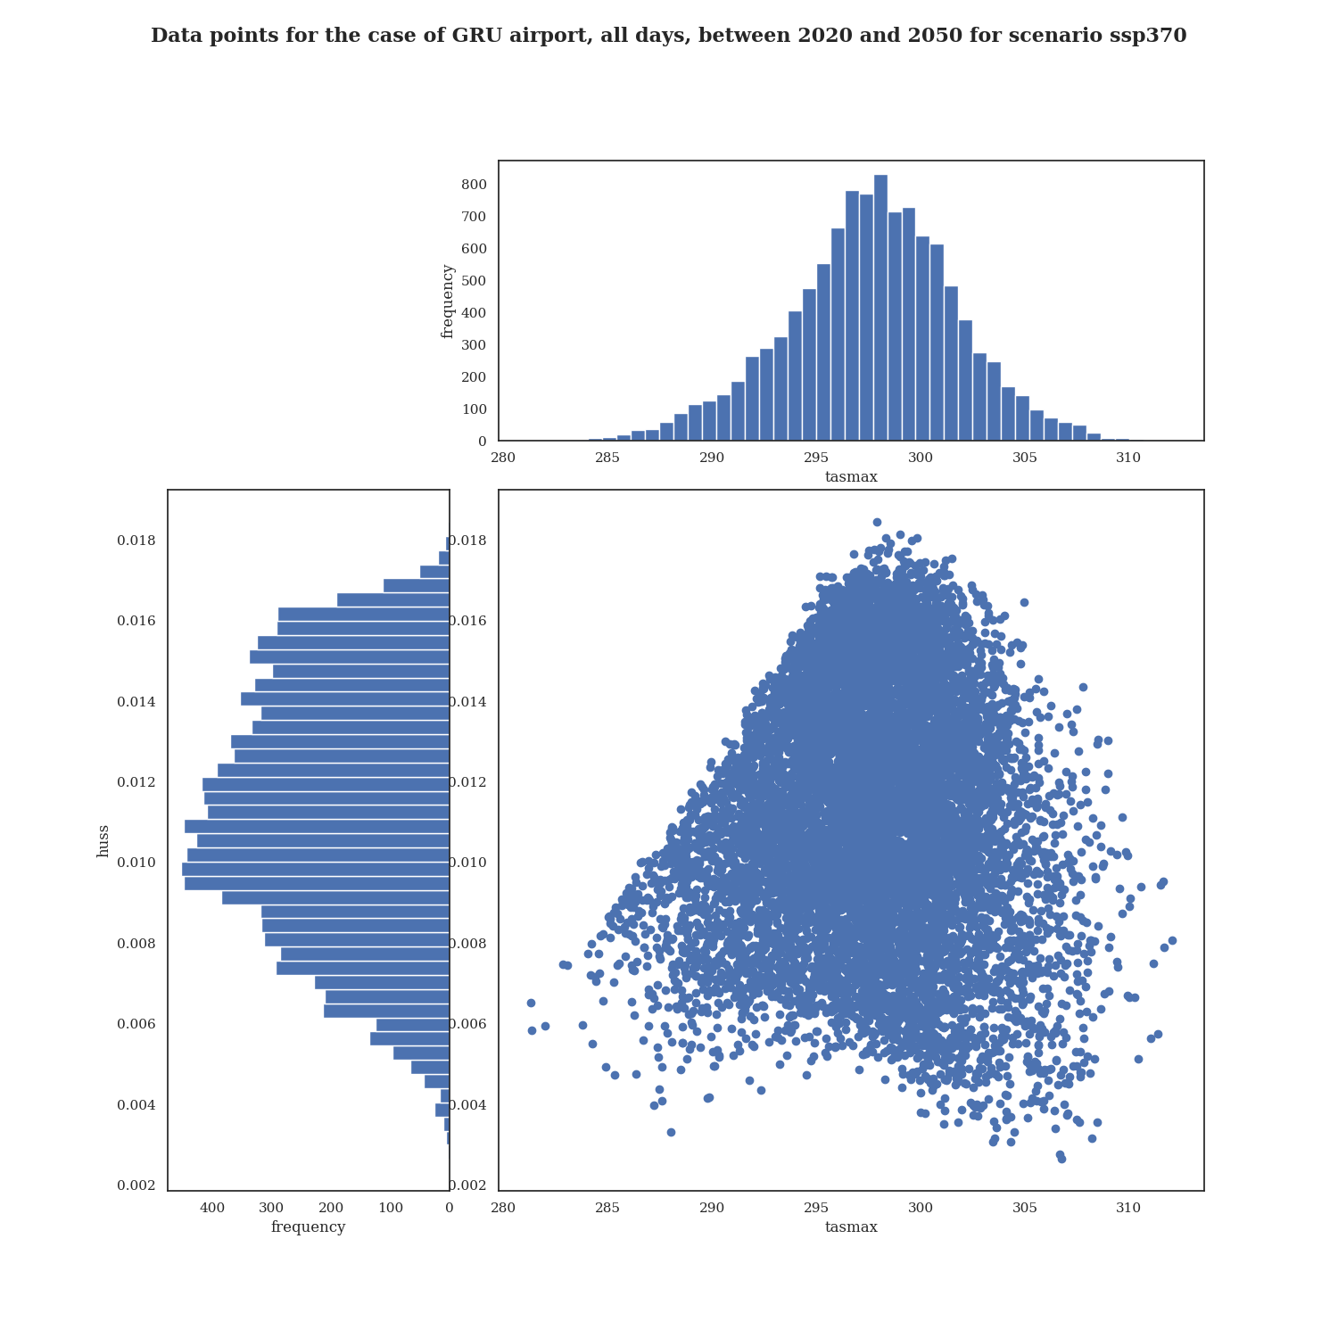
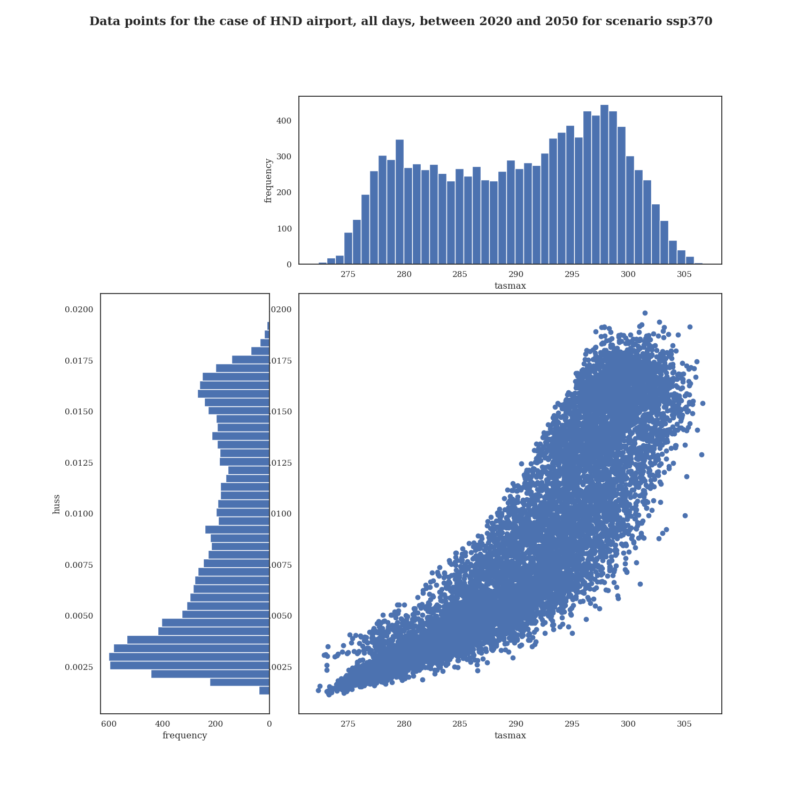
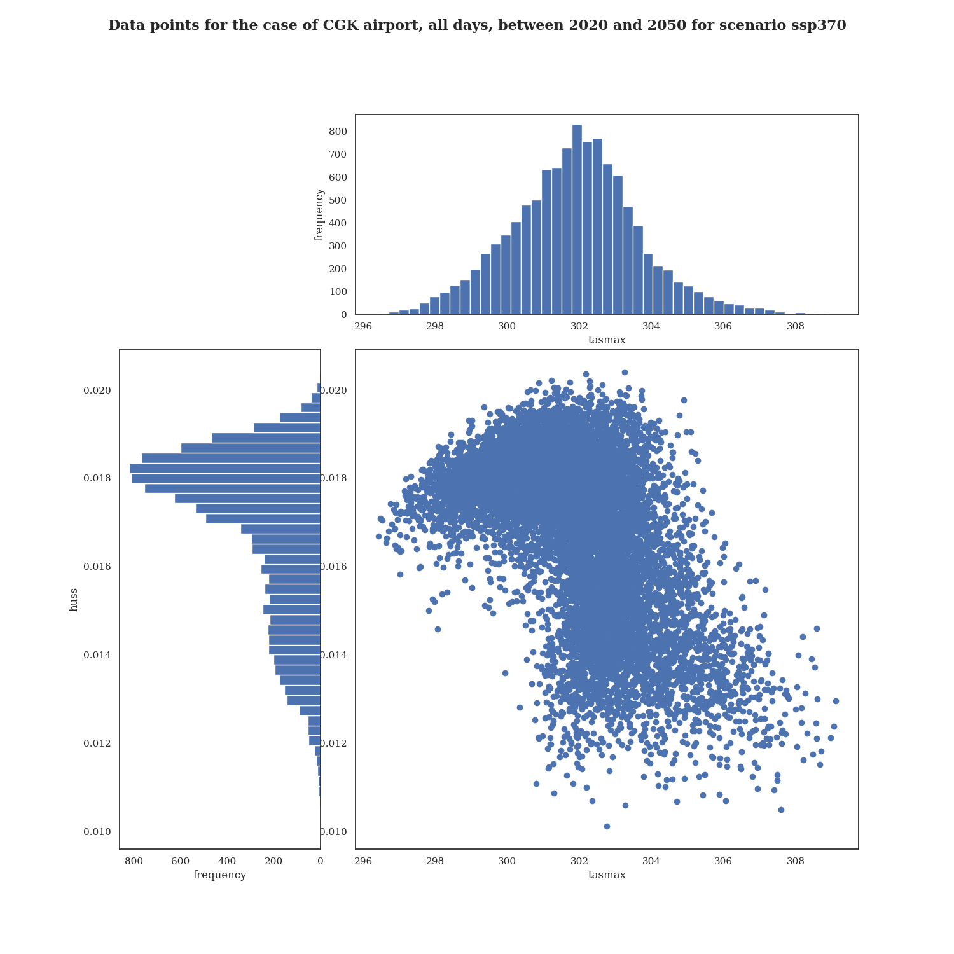
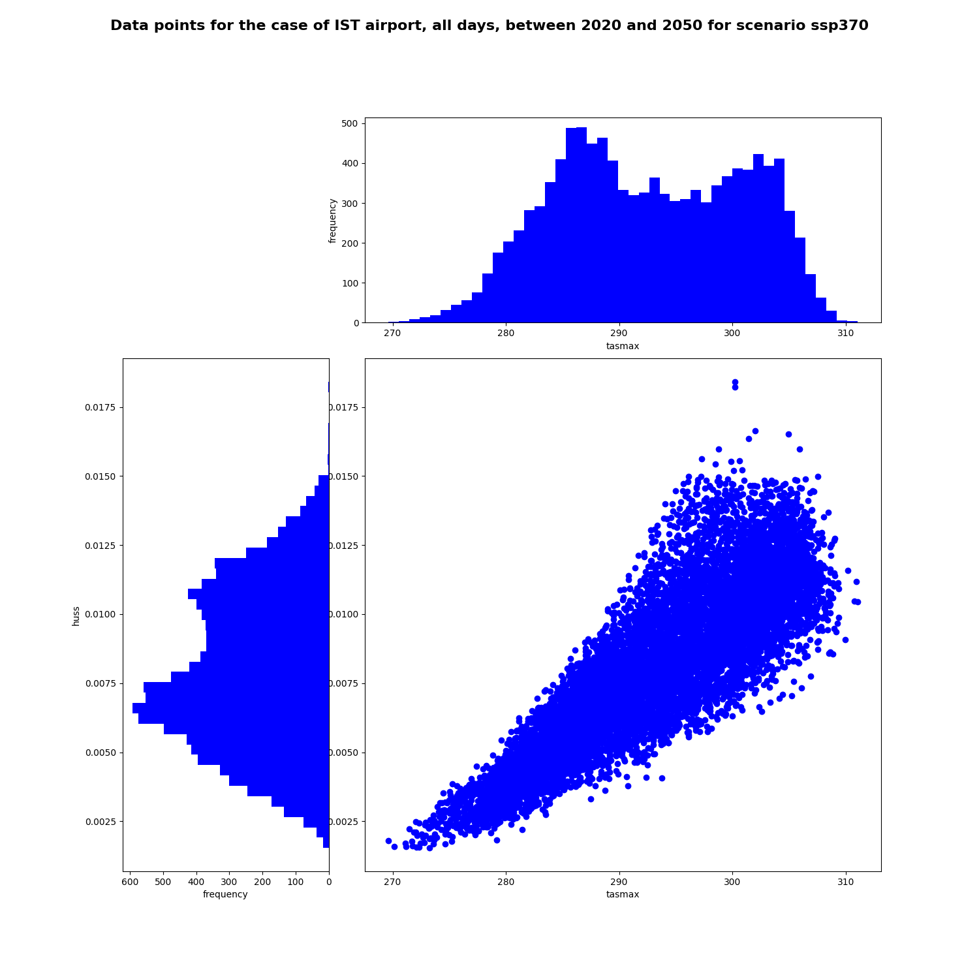
What the data looks like
Toulouse
Sao Paulo
→ In the values space
Daily variables for period 2020-2050
10 956 data points
Scenario SSP 3.7-0
huss
huss
Tasmax and huss correlated?
tasmax
tasmax
Tokyo
Jakarta
Istanbul
huss
huss
huss
tasmax
tasmax
tasmax

Slide 6
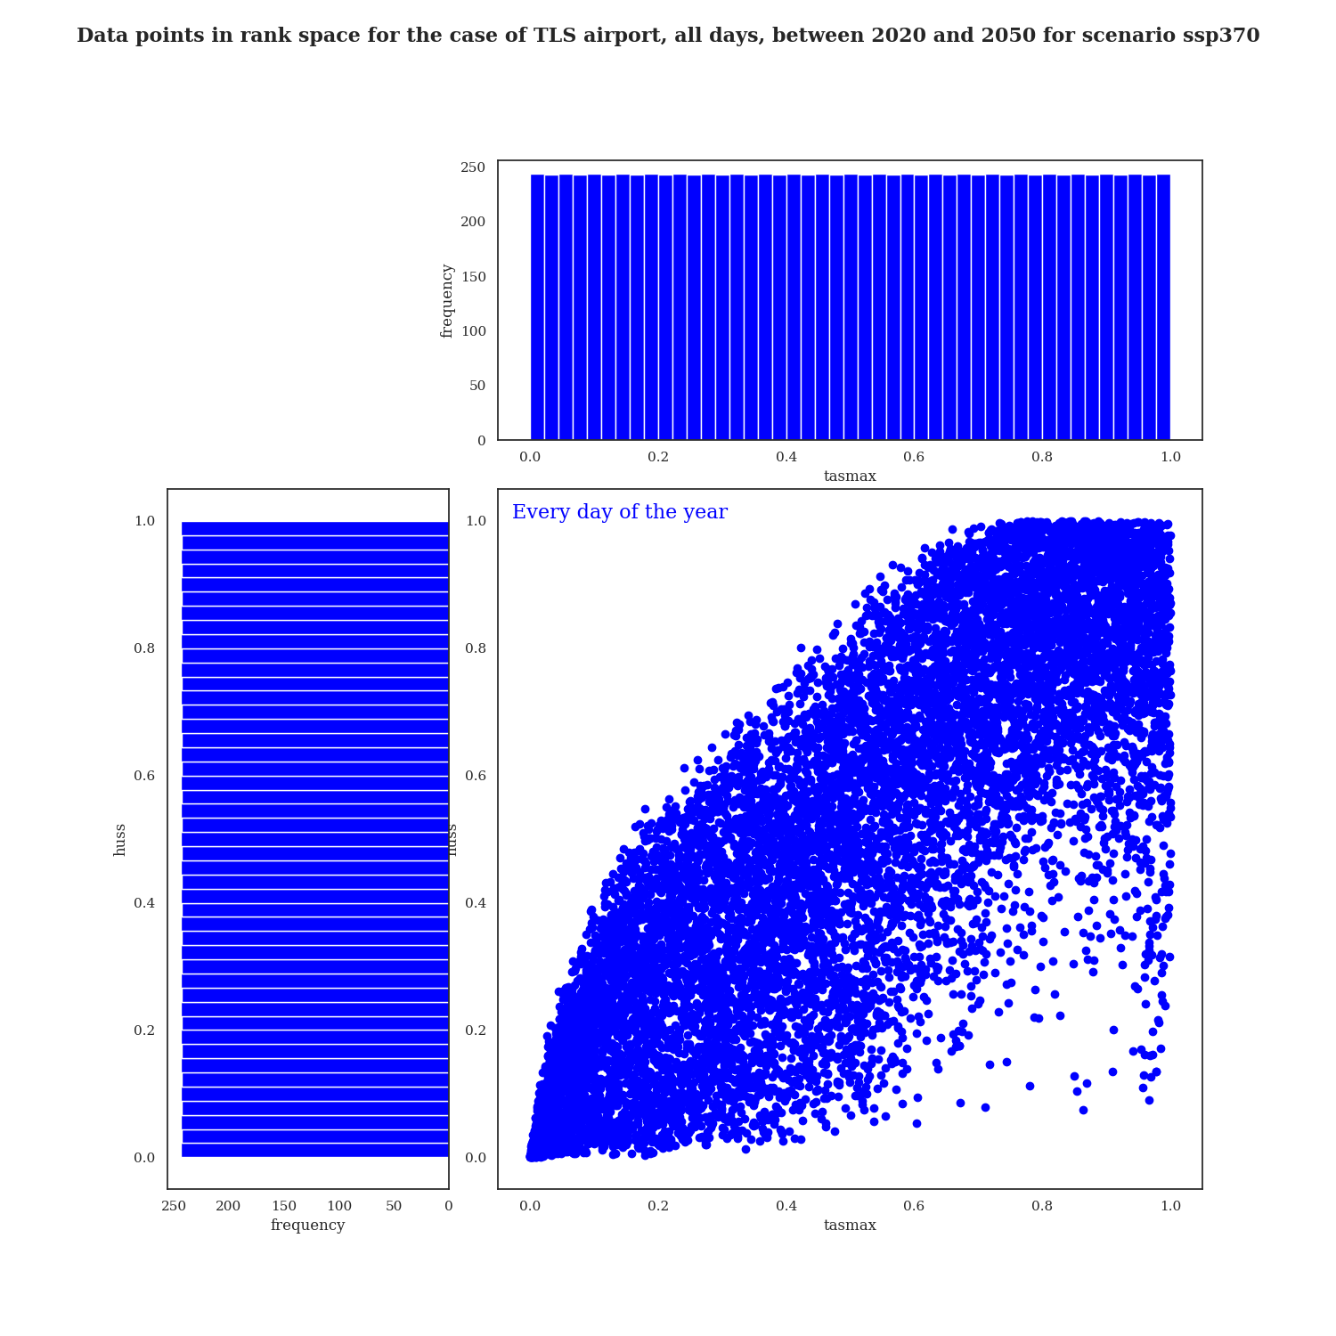
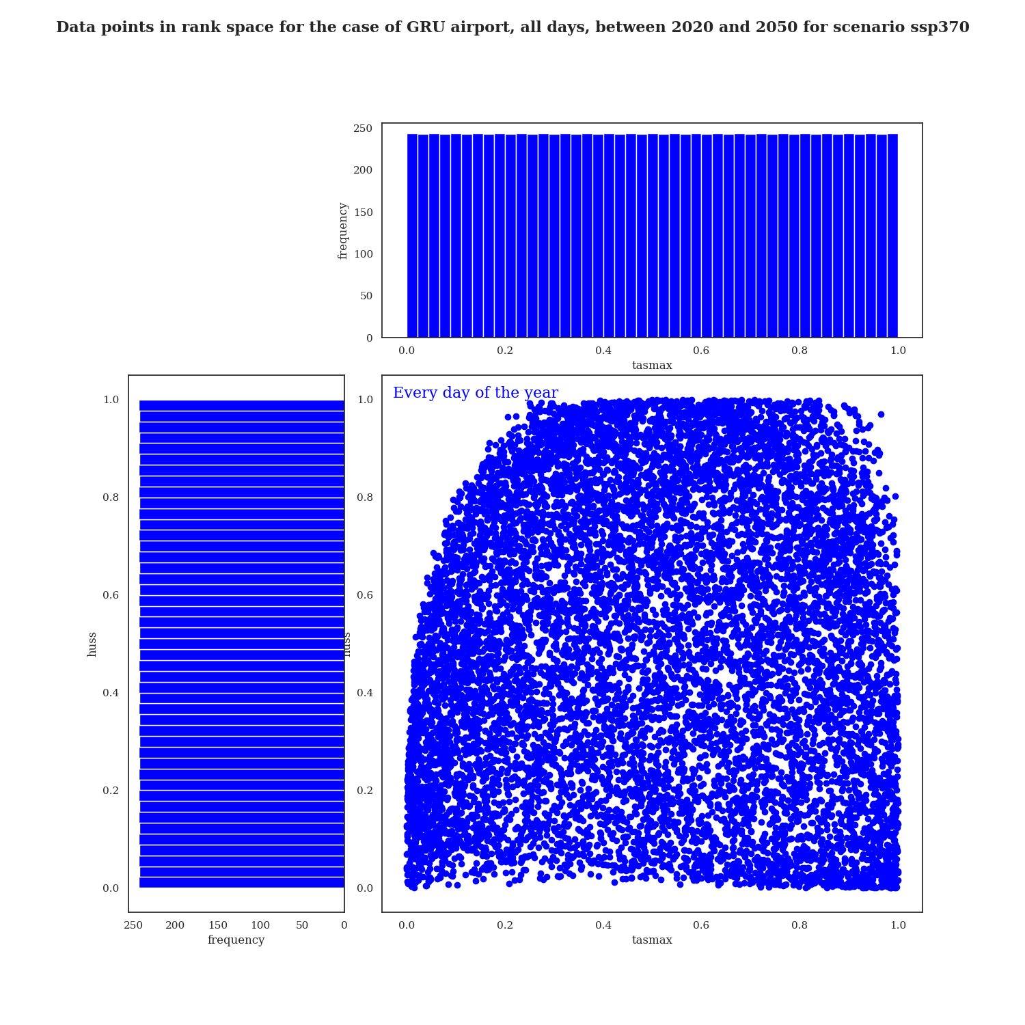
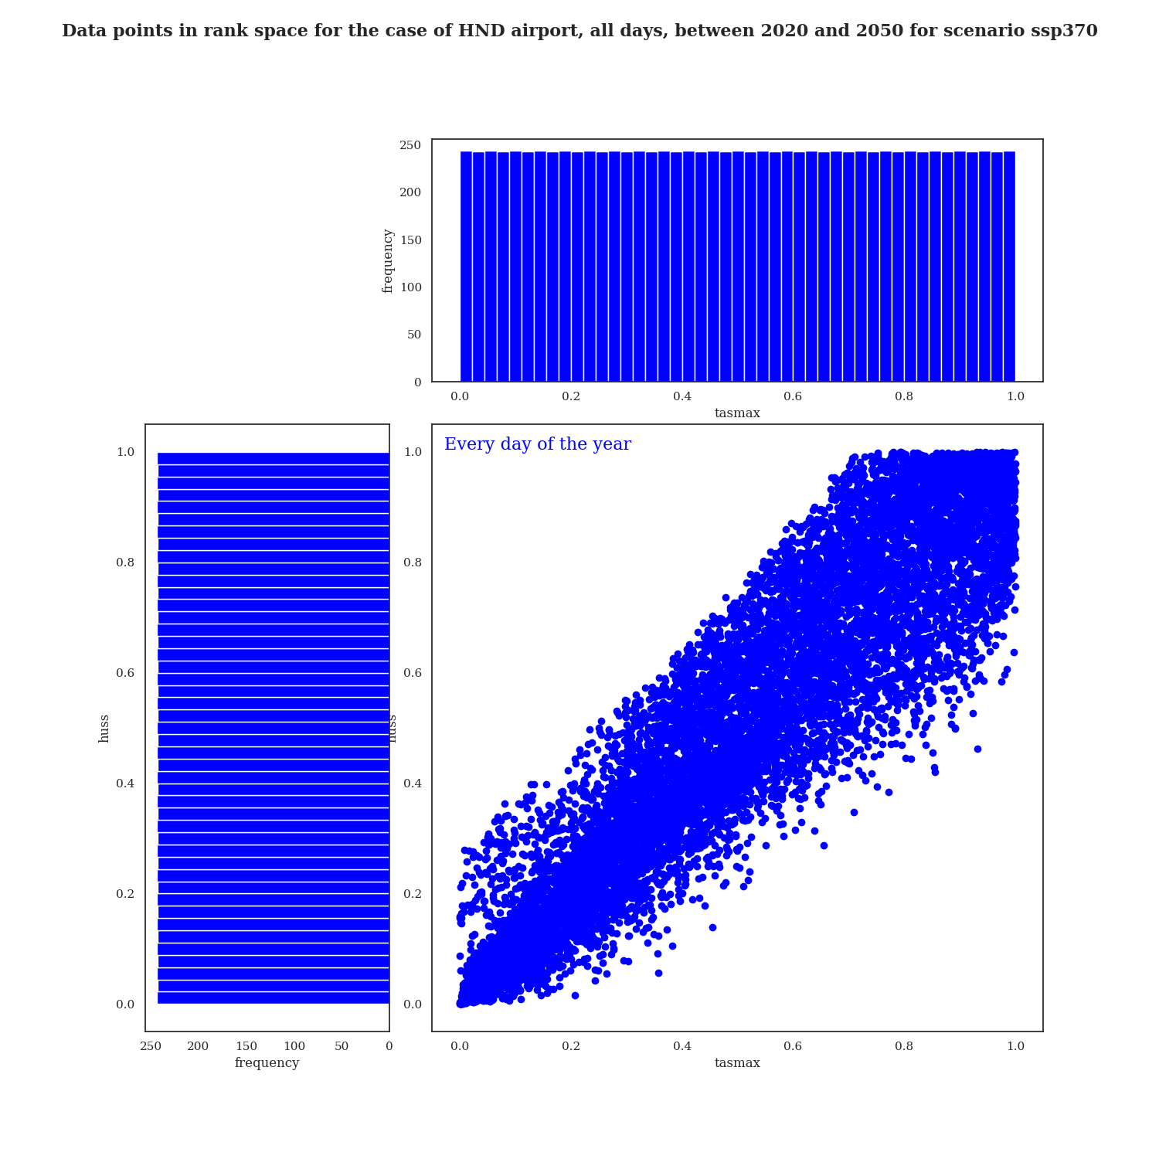
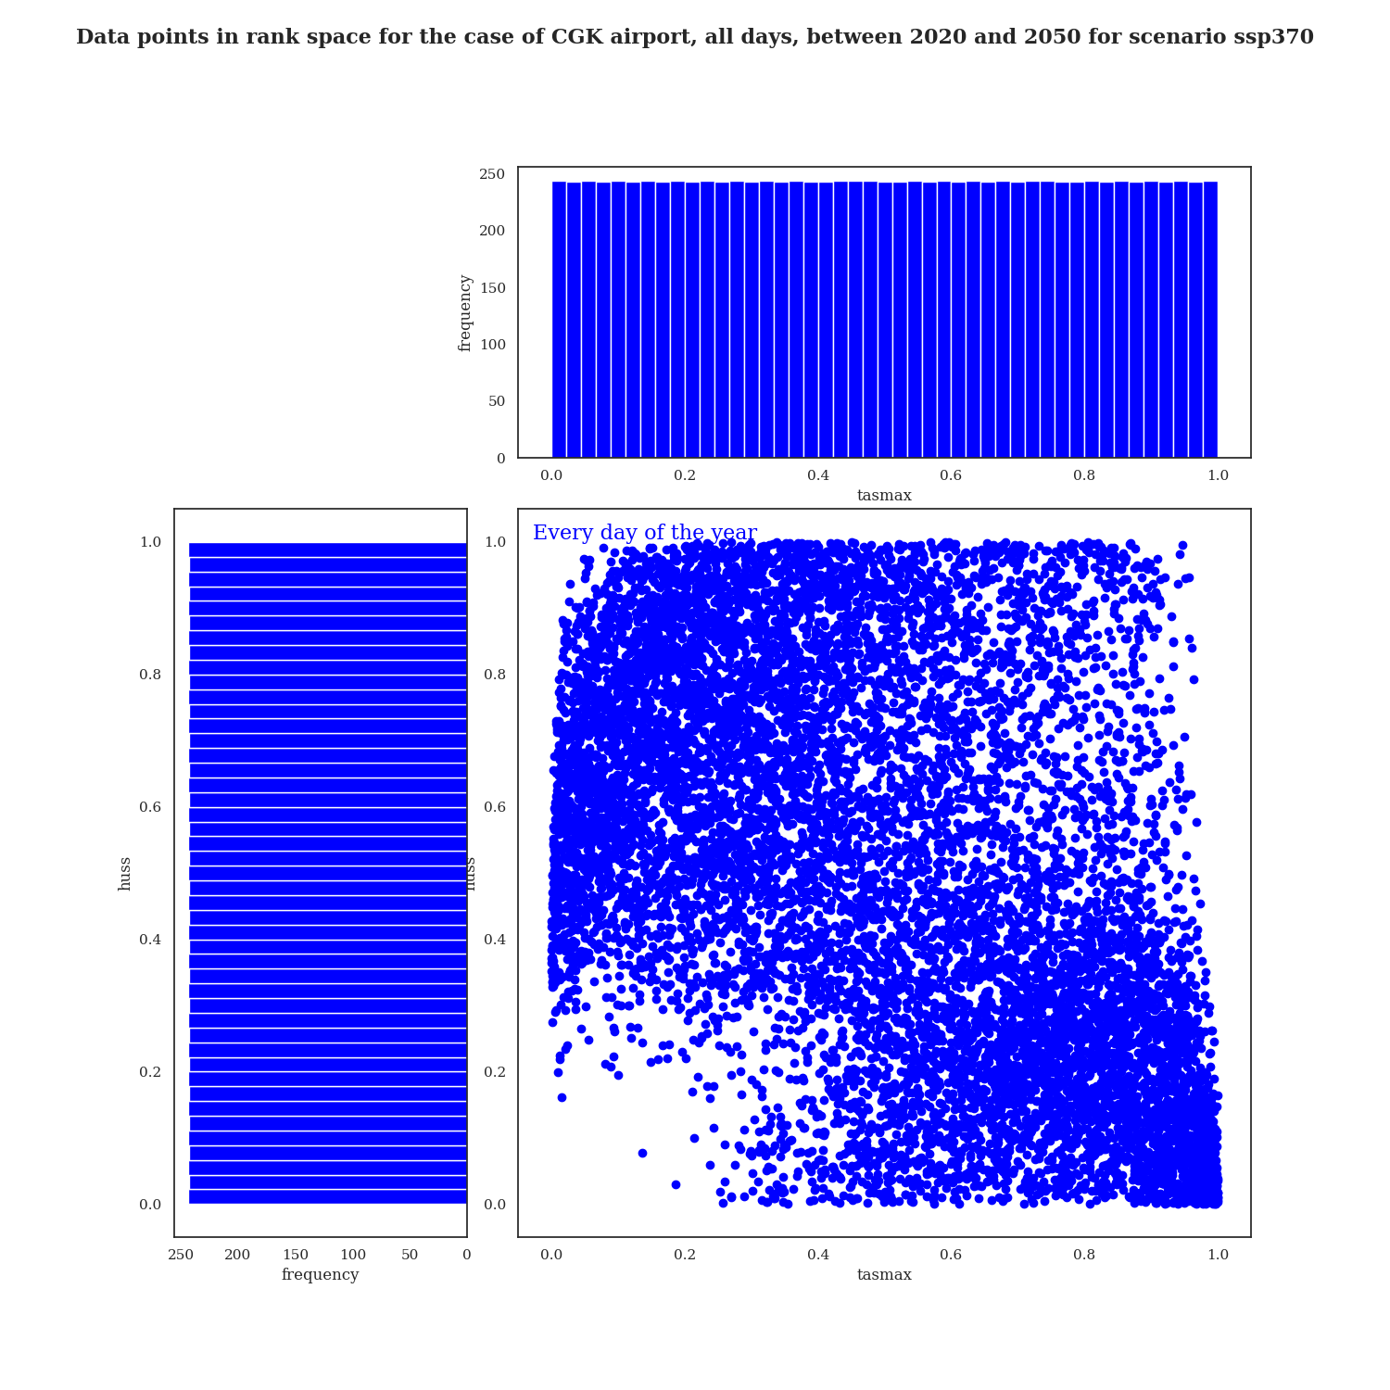
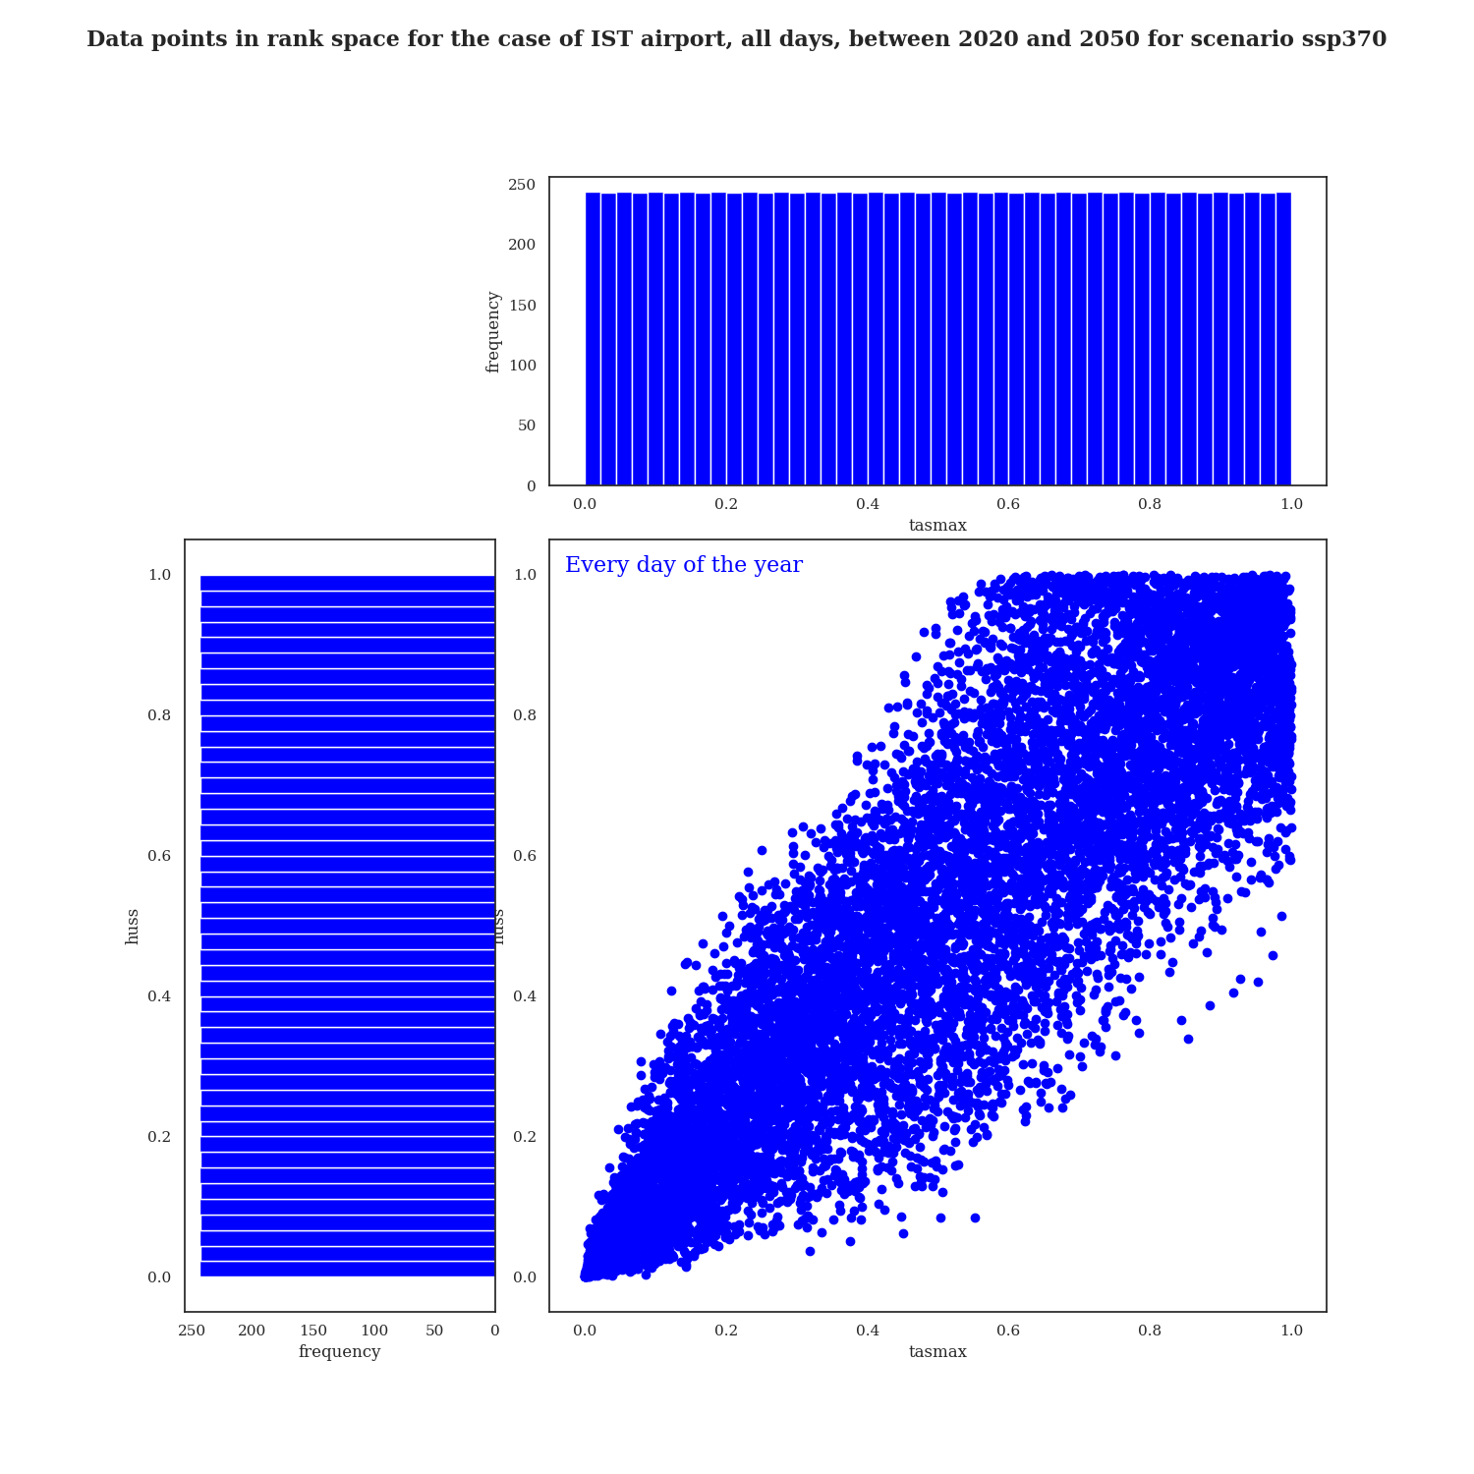
What the data looks like
Toulouse
Sao Paulo
→ In the rank space
Daily variables for period 2020-2050
10 956 data points
Scenario SSP 3.7-0
huss
huss
Tasmax and huss correlated?
tasmax
tasmax
Tokyo
Jakarta
Istanbul
huss
huss
huss
tasmax
tasmax
tasmax
Notes:
Preciser rank space : each component is assigned its rank instead of its value
Marginals become uniform laws, so it allows to see the dependency structure ‘without the influence of the marginals’
Allows to see correlations beyond linear

Slide 7
Focusing on extreme values
1. Summer
2. Quantiles
3. Critical threshold
Notes:
Why? Because sensitivity to normal atmospheric conditions for qhichv the performance is not too impacted doesn’t interest us

Slide 8
Focusing on extreme values
1. Summer
2. Quantiles
3. Critical threshold
Notes:
Why? Because sensitivity to normal atmospheric conditions for qhichv the performance is not too impacted doesn’t interest us

Slide 9
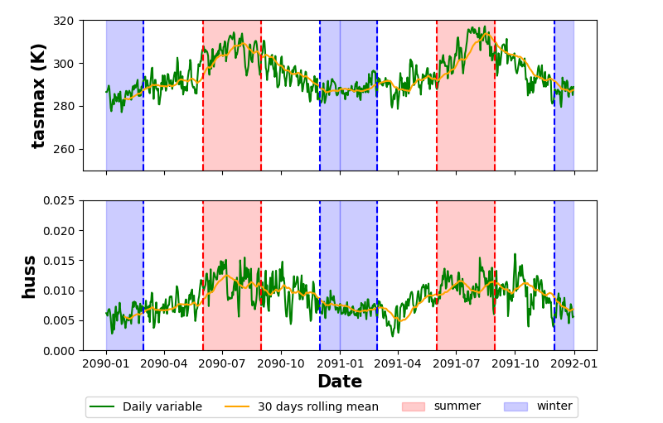
3-month summer restriction
Strict summer definition
North hemisphere:
June, July, August
South hemisphere:
December, January, February
Toulouse
Plot of daily data for 2 years
JF
JJA
DJF
JJA
D
Data fluctuates a lot
Summer season seems to be when the variables are the highest

Slide 10
3-month summer restriction
Strict summer definition
North hemisphere:
June, July, August
South hemisphere:
December, January, February
Correlation coefficients :
Pearson : 0.77
Spearman : 0.81
Toulouse
Every day of the year:
10 956 points
Notes:
First approach: since we are interested in extreme values, we want to focus on summer days (in red)
extreme cases : hot days

Slide 11
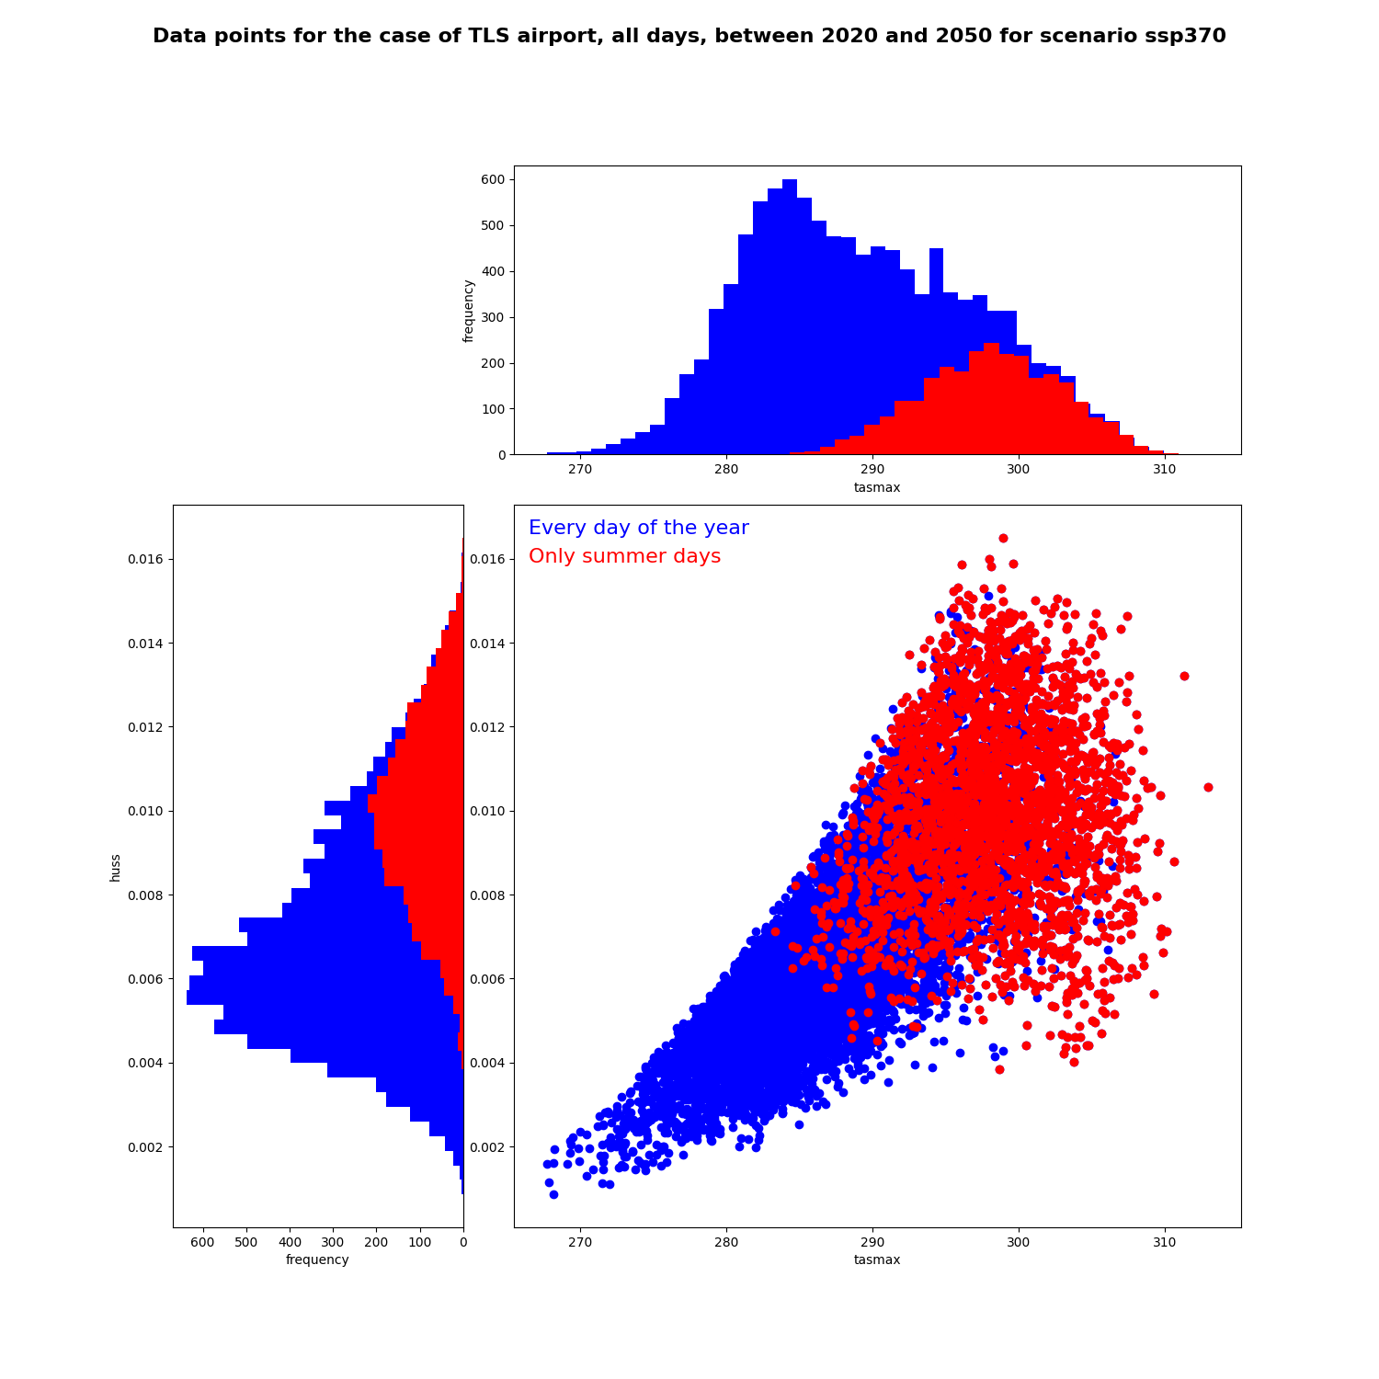
3-month summer restriction
Strict summer definition
North hemisphere:
June, July, August
South hemisphere:
December, January, February
Correlation coefficients :
Pearson : 0.77
Spearman : 0.81
Pearson : 0.10
Spearman : 0.089
Toulouse
frequency
Every day of the year:
10 956 points
Only summer days:
2 700 points
huss
Pros: fixed window of 90 days per year for any case
Cons: doesn’t necessarily apply to tropical climate
frequency
tasmax
Notes:
First approach: since we are interested in extreme values, we want to focus on summer days (in red)
At first glance, the distribution then seems to show less correlation and the marginals seem unimodal

Slide 12
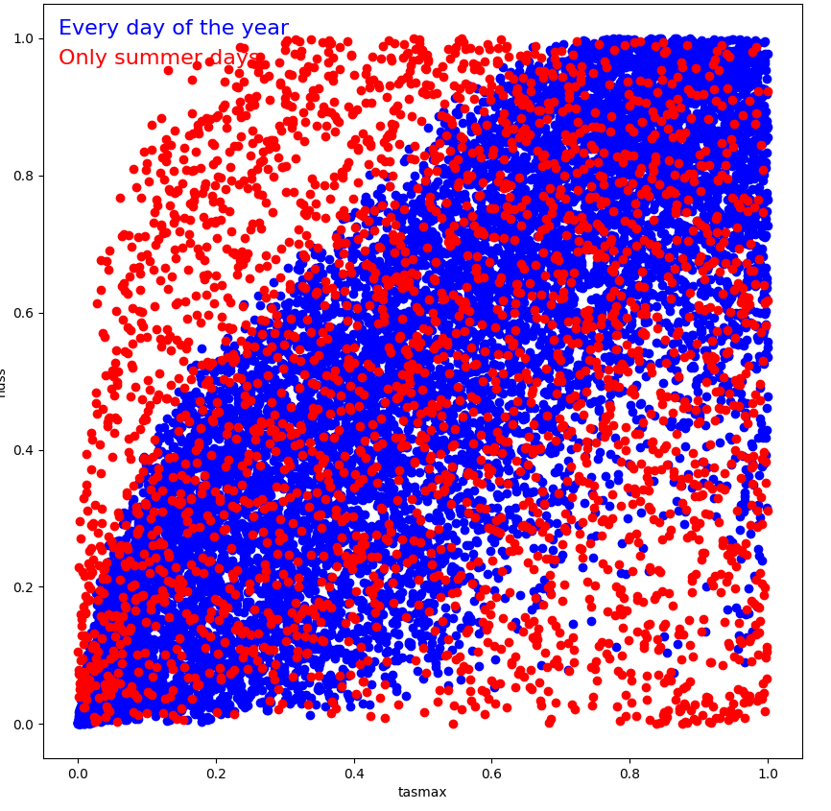
3-month summer restriction
Strict summer definition
North hemisphere:
June, July, August
South hemisphere:
December, January, February
Correlation coefficients :
Pearson : 0.77
Spearman : 0.81
Pearson : 0.10
Spearman : 0.089
Toulouse
frequency
Every day of the year:
10 956 points
Only summer days:
2 700 points
→ In the rank space
huss
Pros: fixed window of 90 days per year for any case
Cons: doesn’t necessarily apply to tropical climate
frequency
tasmax
Notes:
First approach: since we are interested in extreme values, we want to focus on summer days (in red)
At first glance, the distribution then seems to show less correlation and the marginals seem unimodal

Slide 13
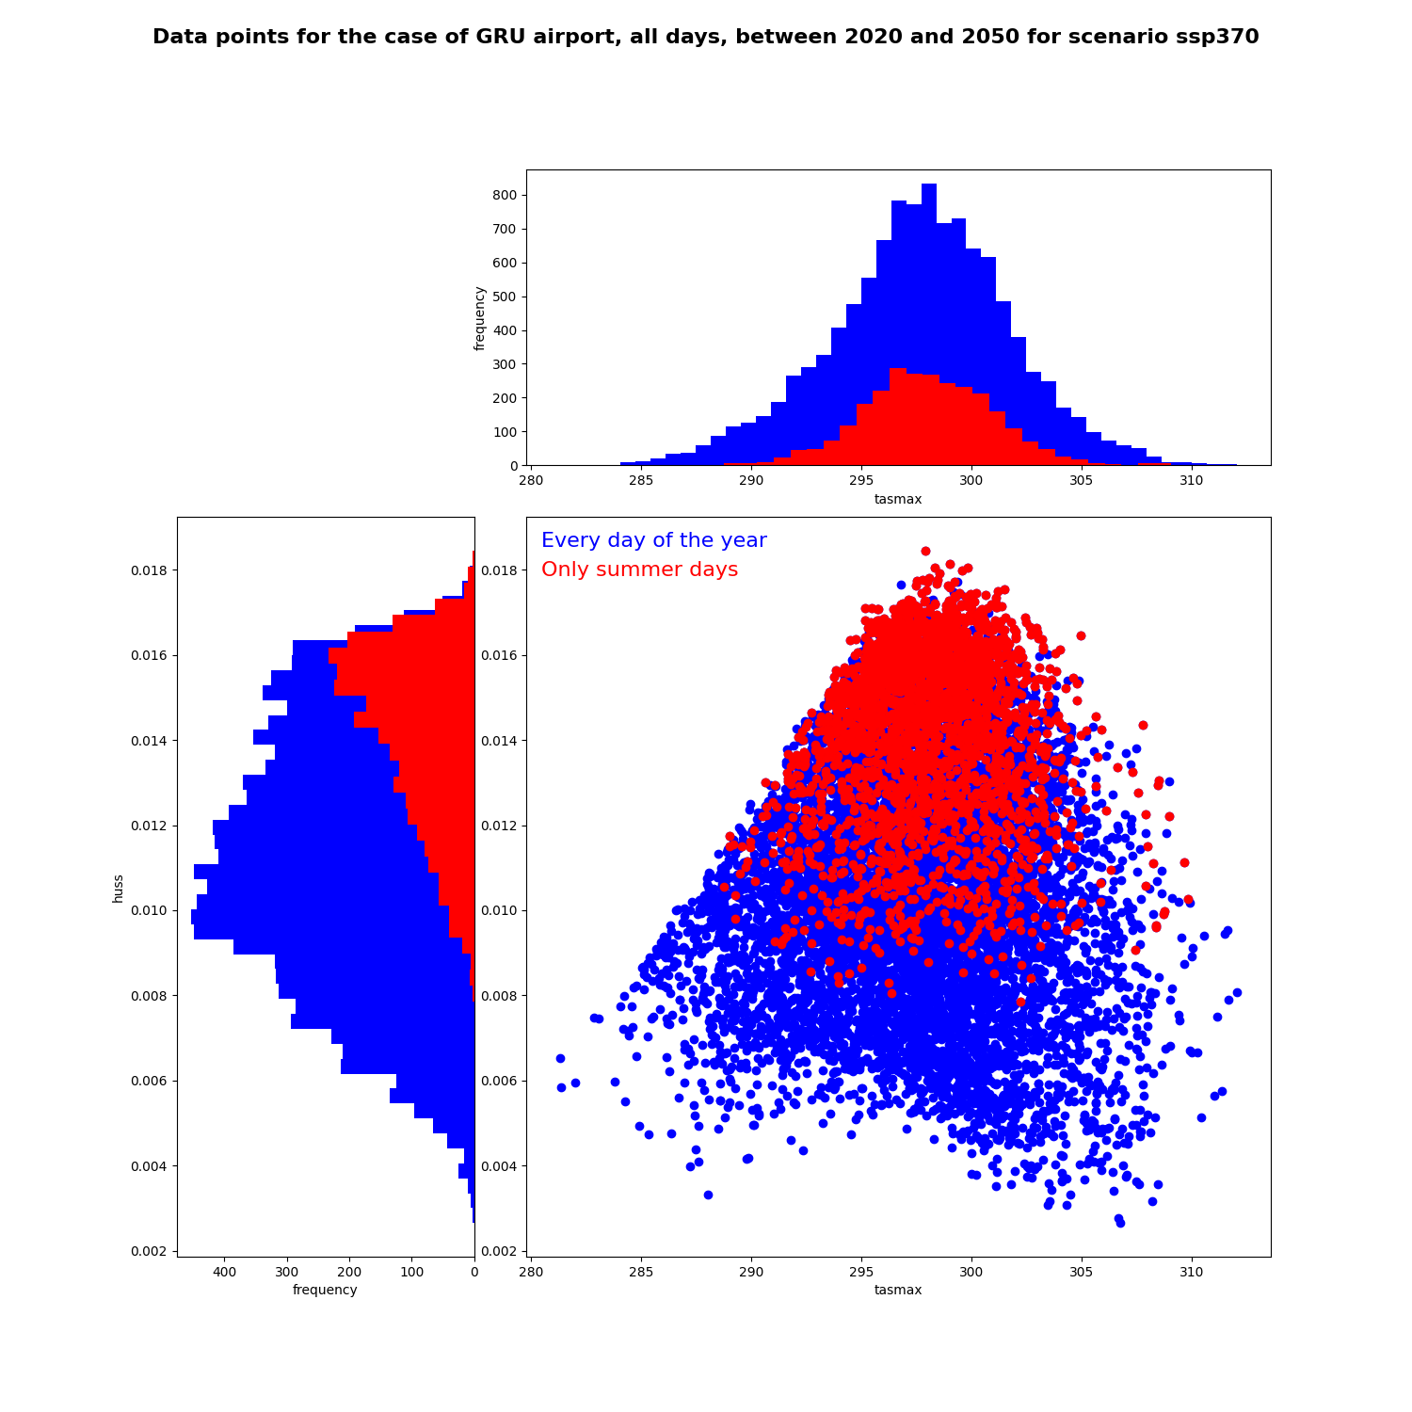
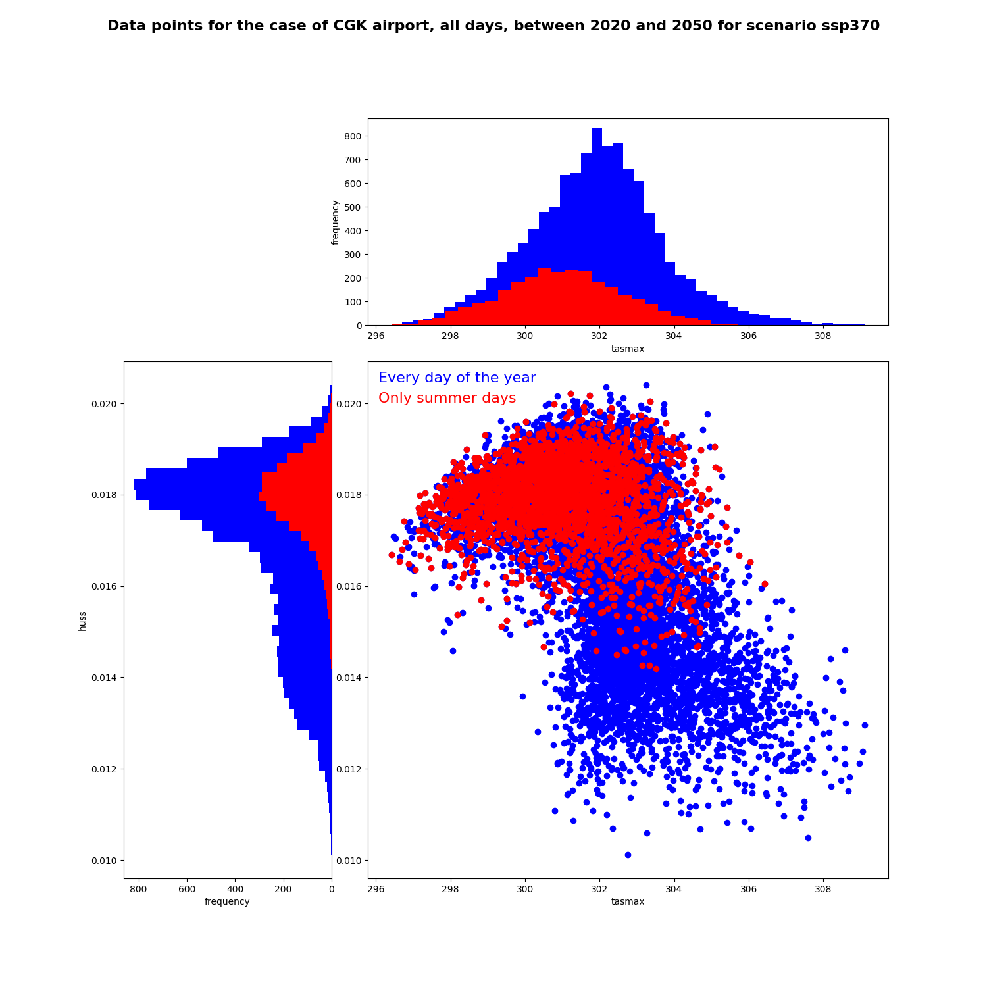
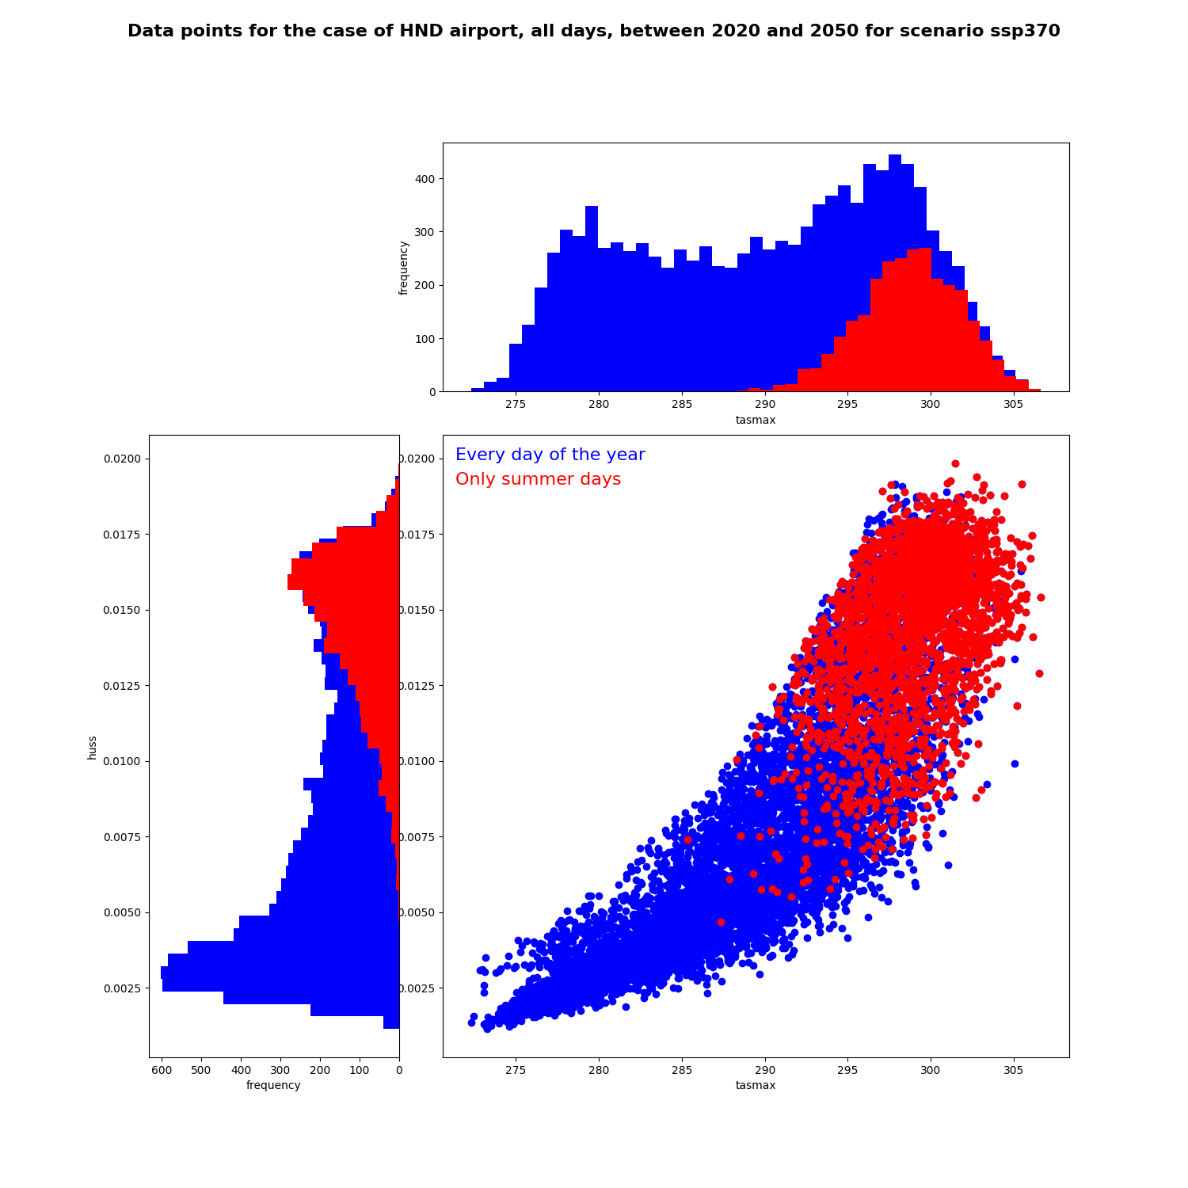
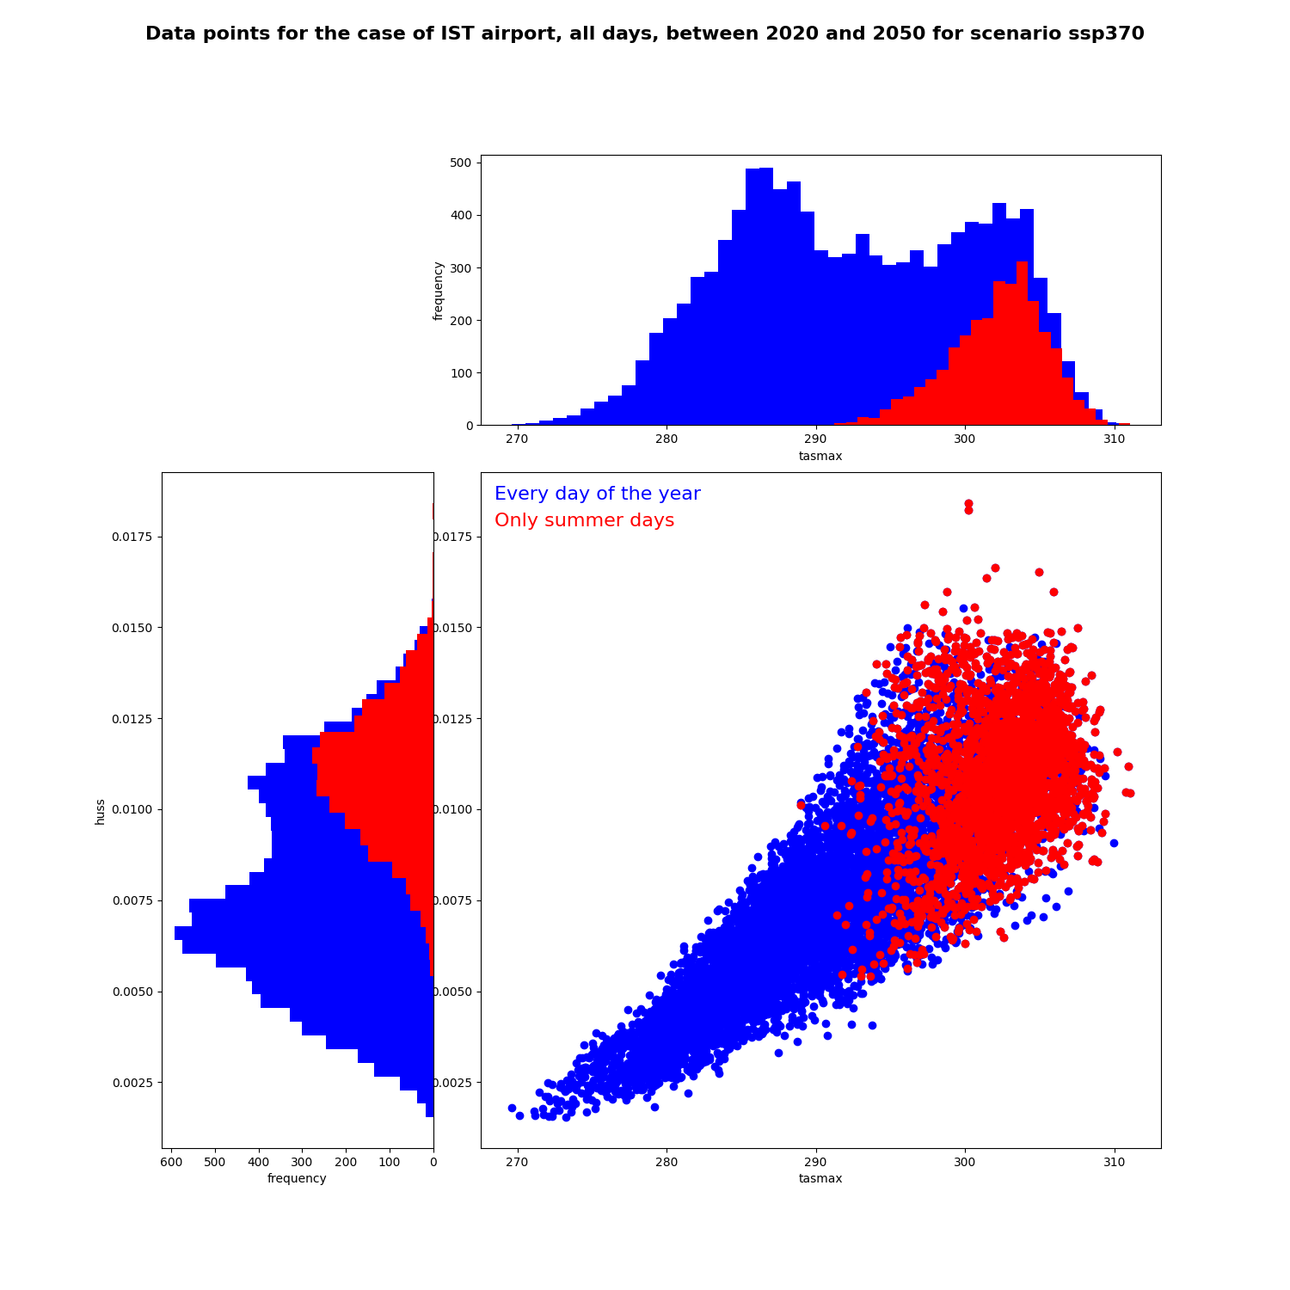
Other distributions for other airports
There seems to be correlation between variables, different depending on the case
How to describe the dependency?
We need a method that will apply to all cases
Sao Paulo
Jakarta
Strict summer definition
North hemisphere:
June, July, August
South hemisphere:
December, January, February
huss
huss
Every day of the year:
10 956 points
Only summer days:
2 700 points
Tokyo
tasmax
Istanbul
tasmax
huss
huss
tasmax
tasmax
Notes:
There seems to be correlation between variables, different depending on the case
How to describe the dependency?
We need a method that will apply to all cases

Slide 14
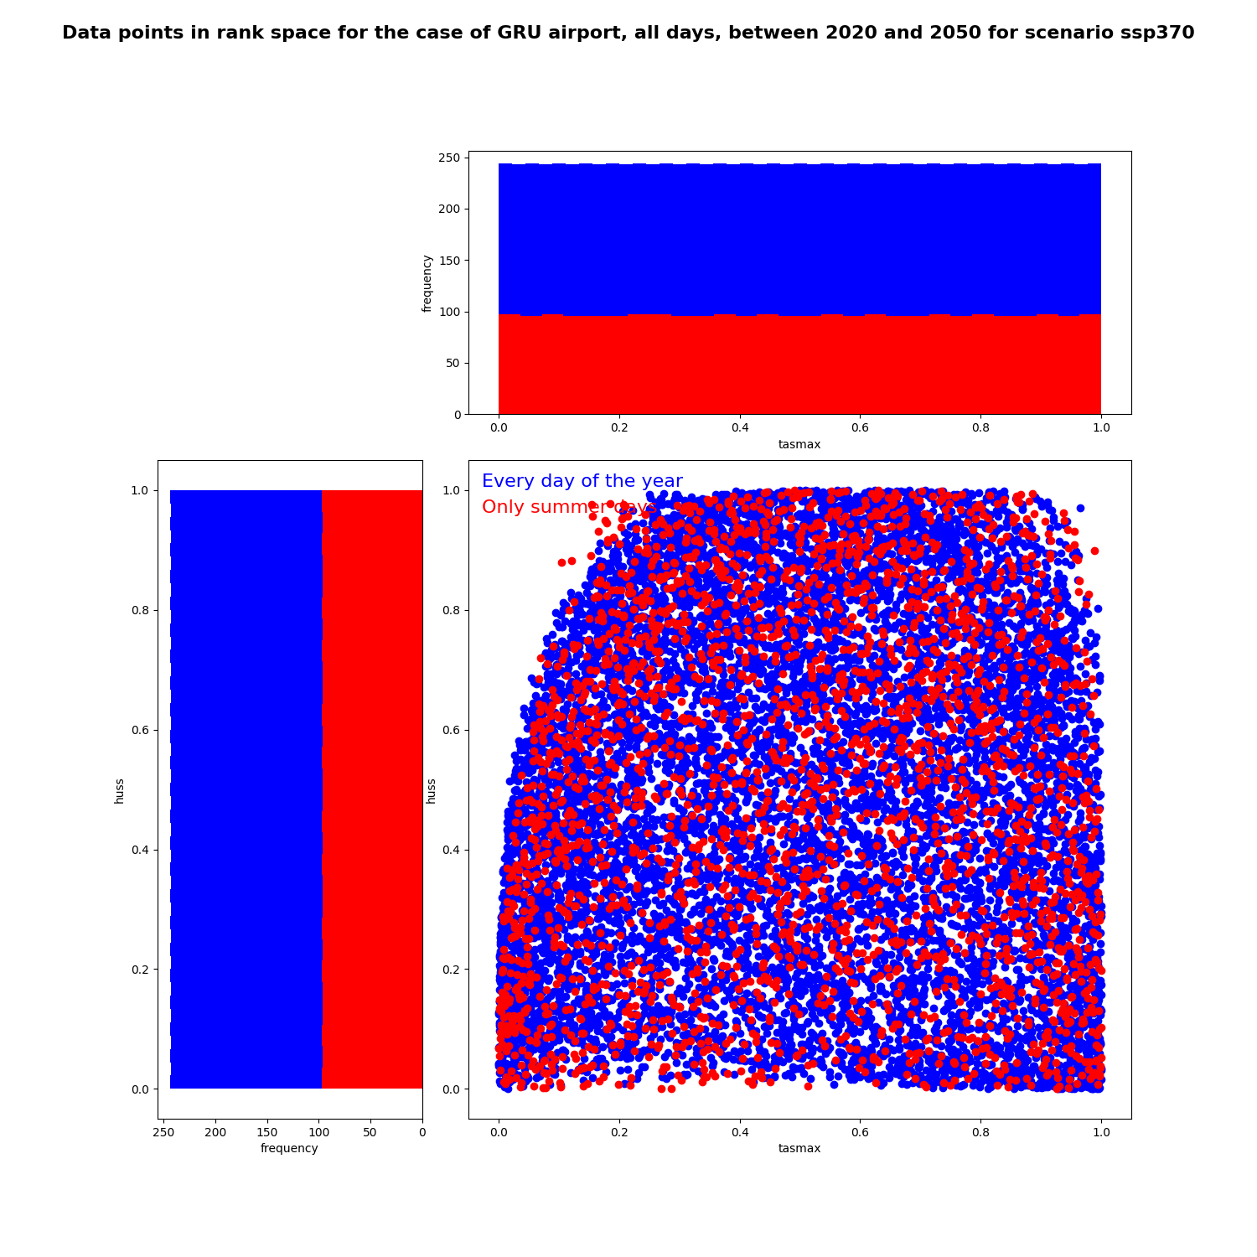
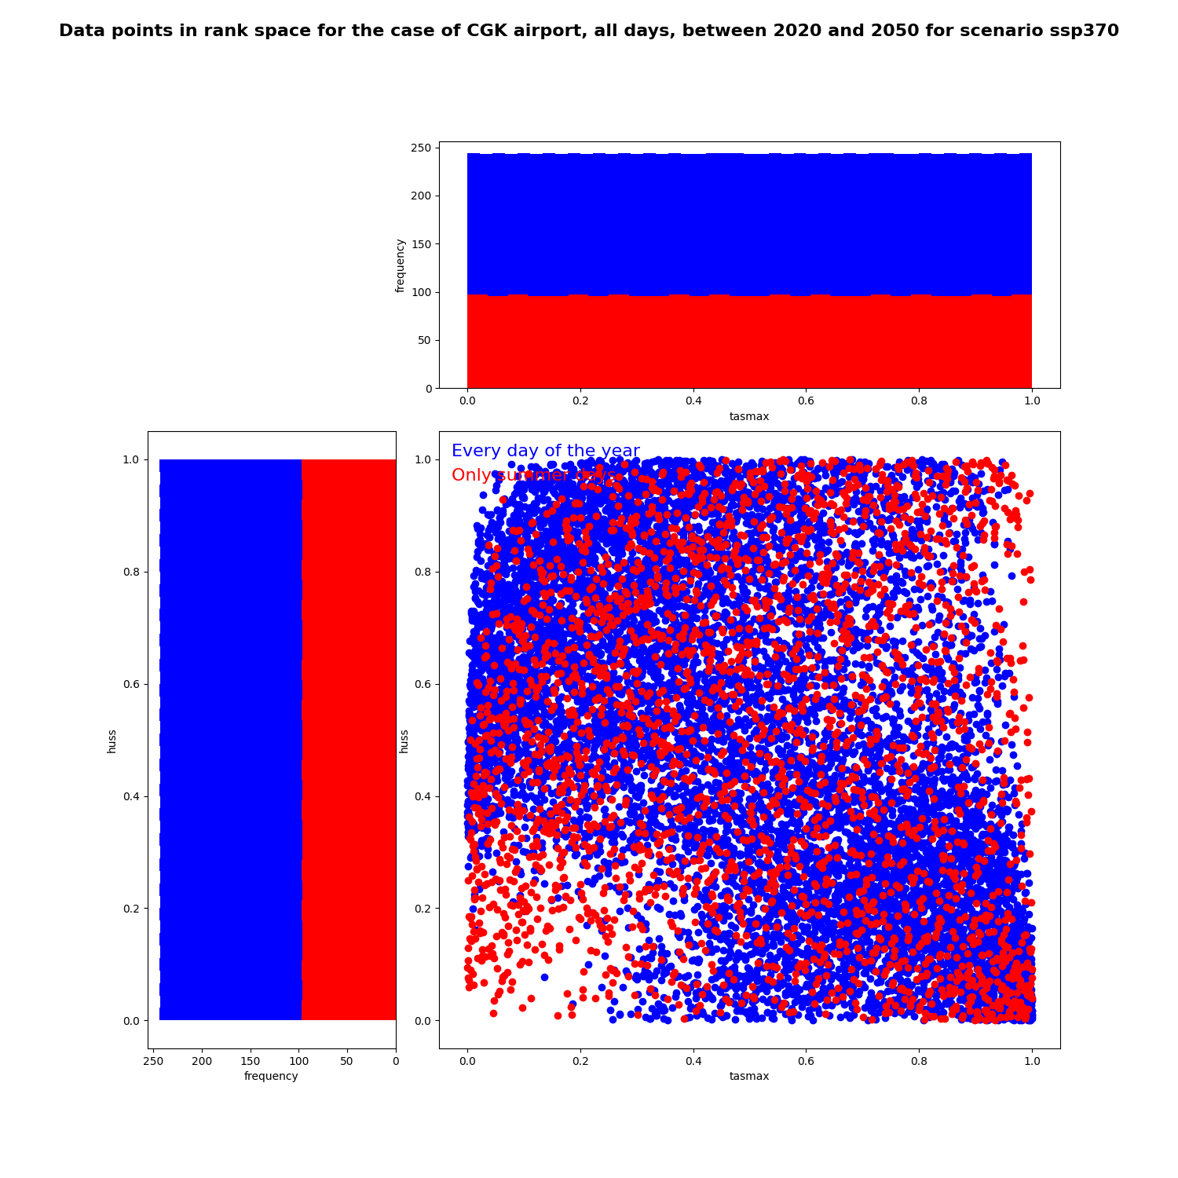
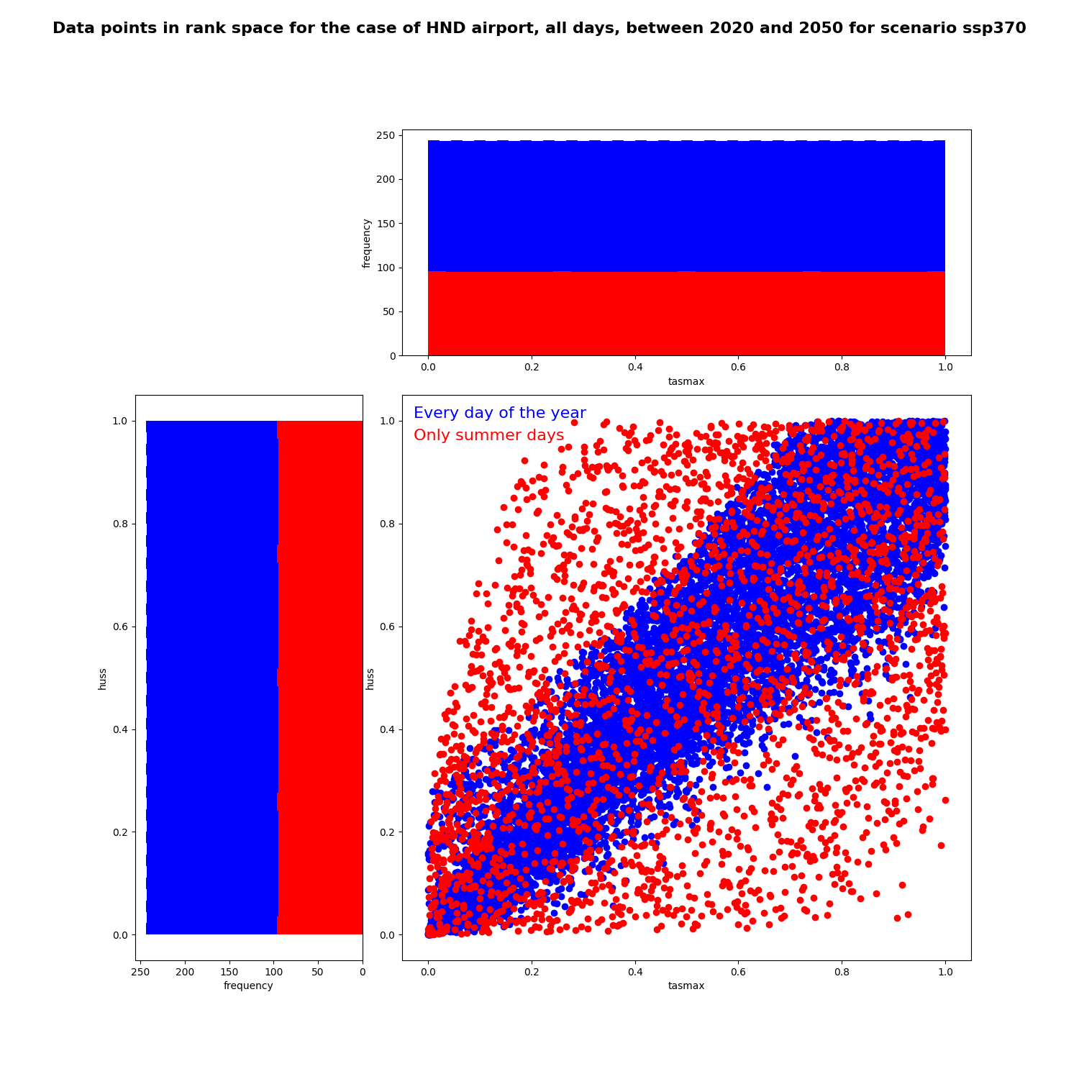
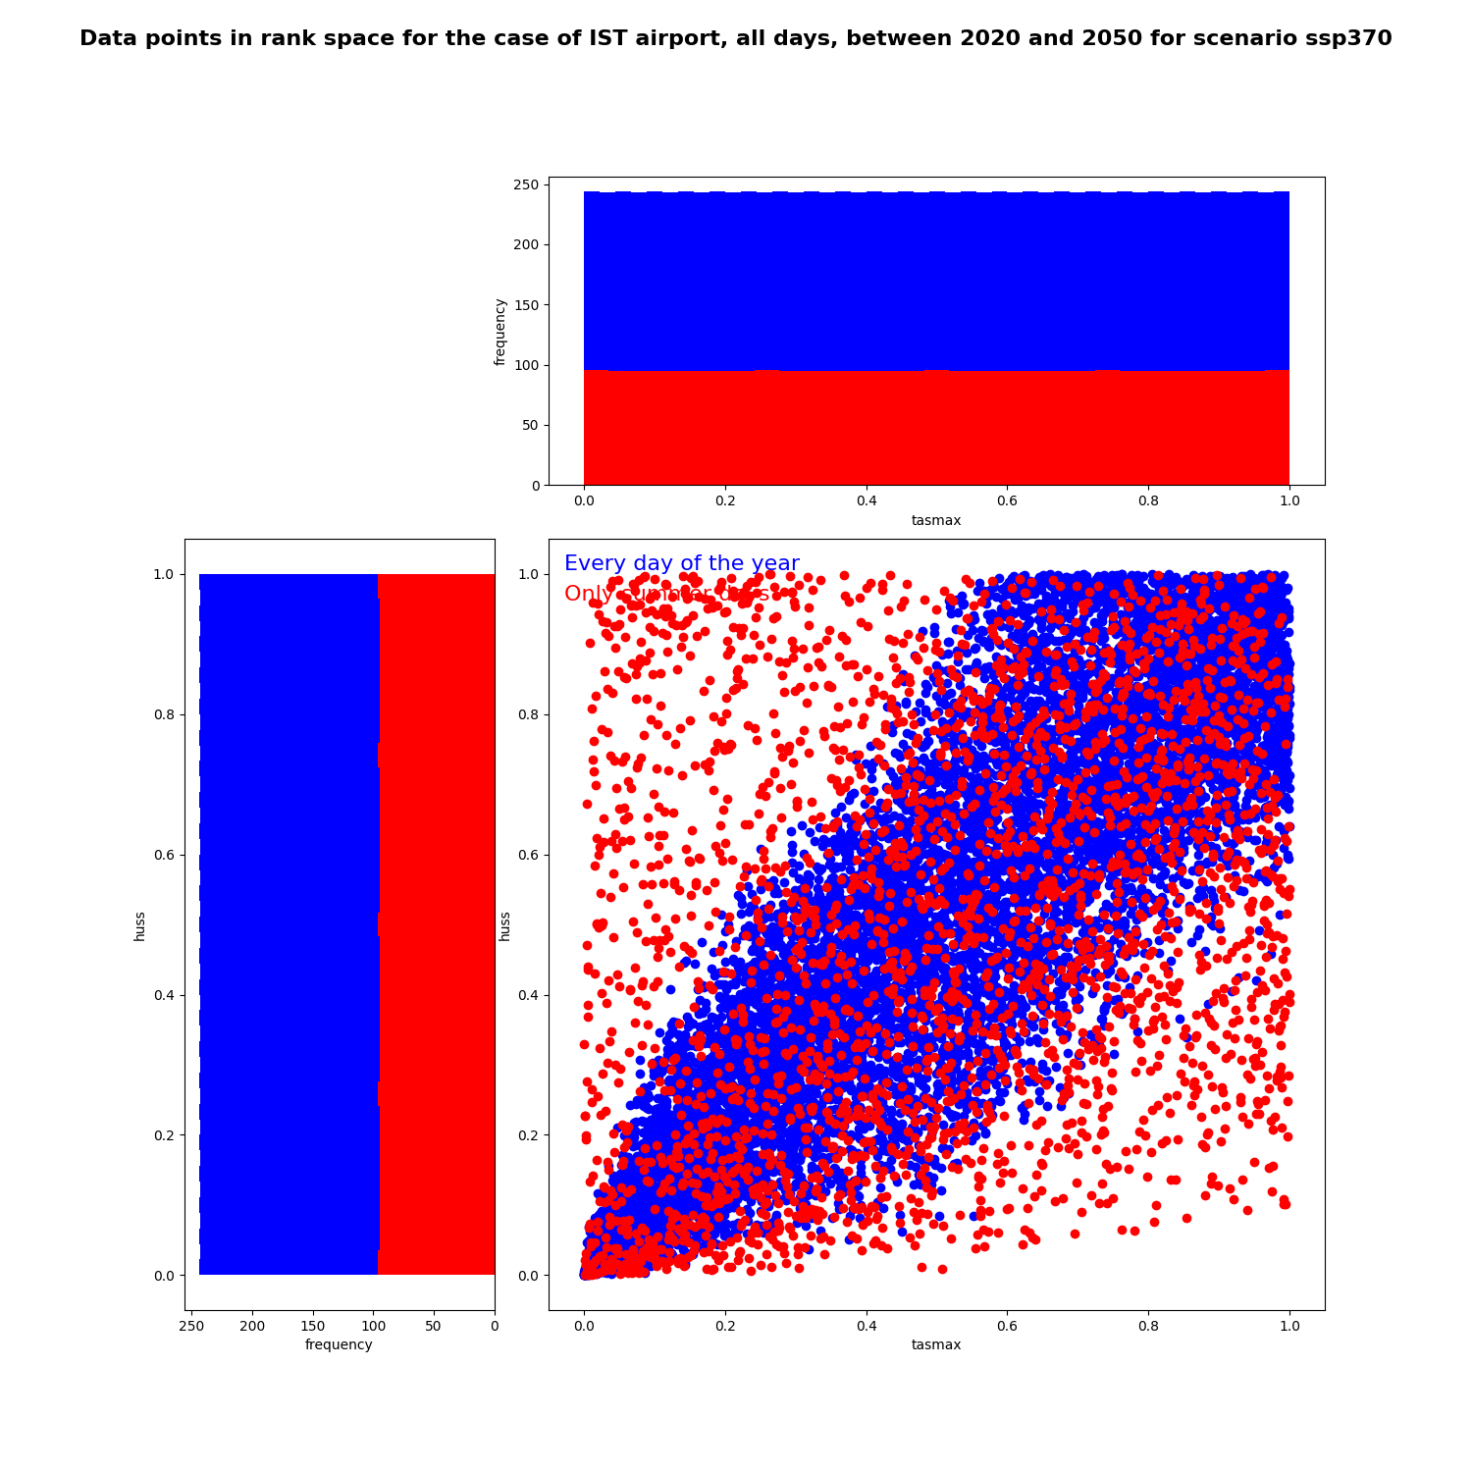
Other distributions for other airports
There seems to be correlation between variables, different depending on the case
How to describe the dependency?
We need a method that will apply to all cases
Sao Paulo
Jakarta
Strict summer definition
North hemisphere:
June, July, August
South hemisphere:
December, January, February
huss
huss
Every day of the year:
10 956 points
Only summer days:
2 700 points
→ In the rank space
Tokyo
tasmax
Istanbul
tasmax
huss
huss
tasmax
tasmax
Notes:
There seems to be correlation between variables, different depending on the case
How to describe the dependency?
We need a method that will apply to all cases

Slide 15
Focusing on extreme values
1. Summer
2. Extreme quantiles
3. Critical threshold
Notes:
Why? Because sensitivity to normal atmospheric conditions for qhichv the performance is not too impacted doesn’t interest us

Slide 16
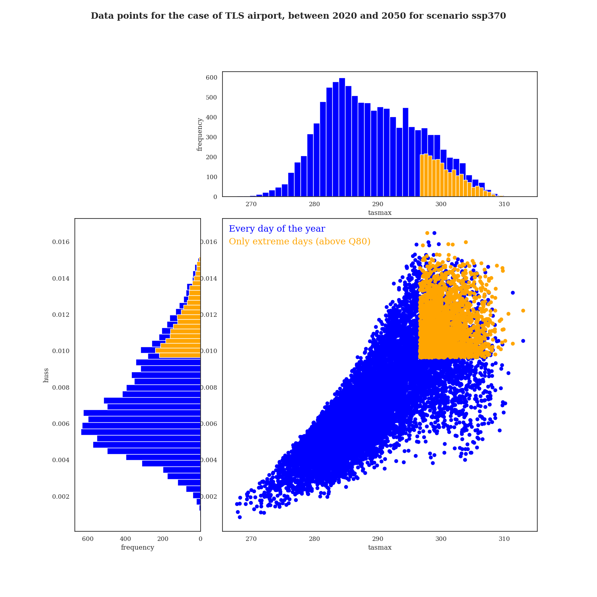
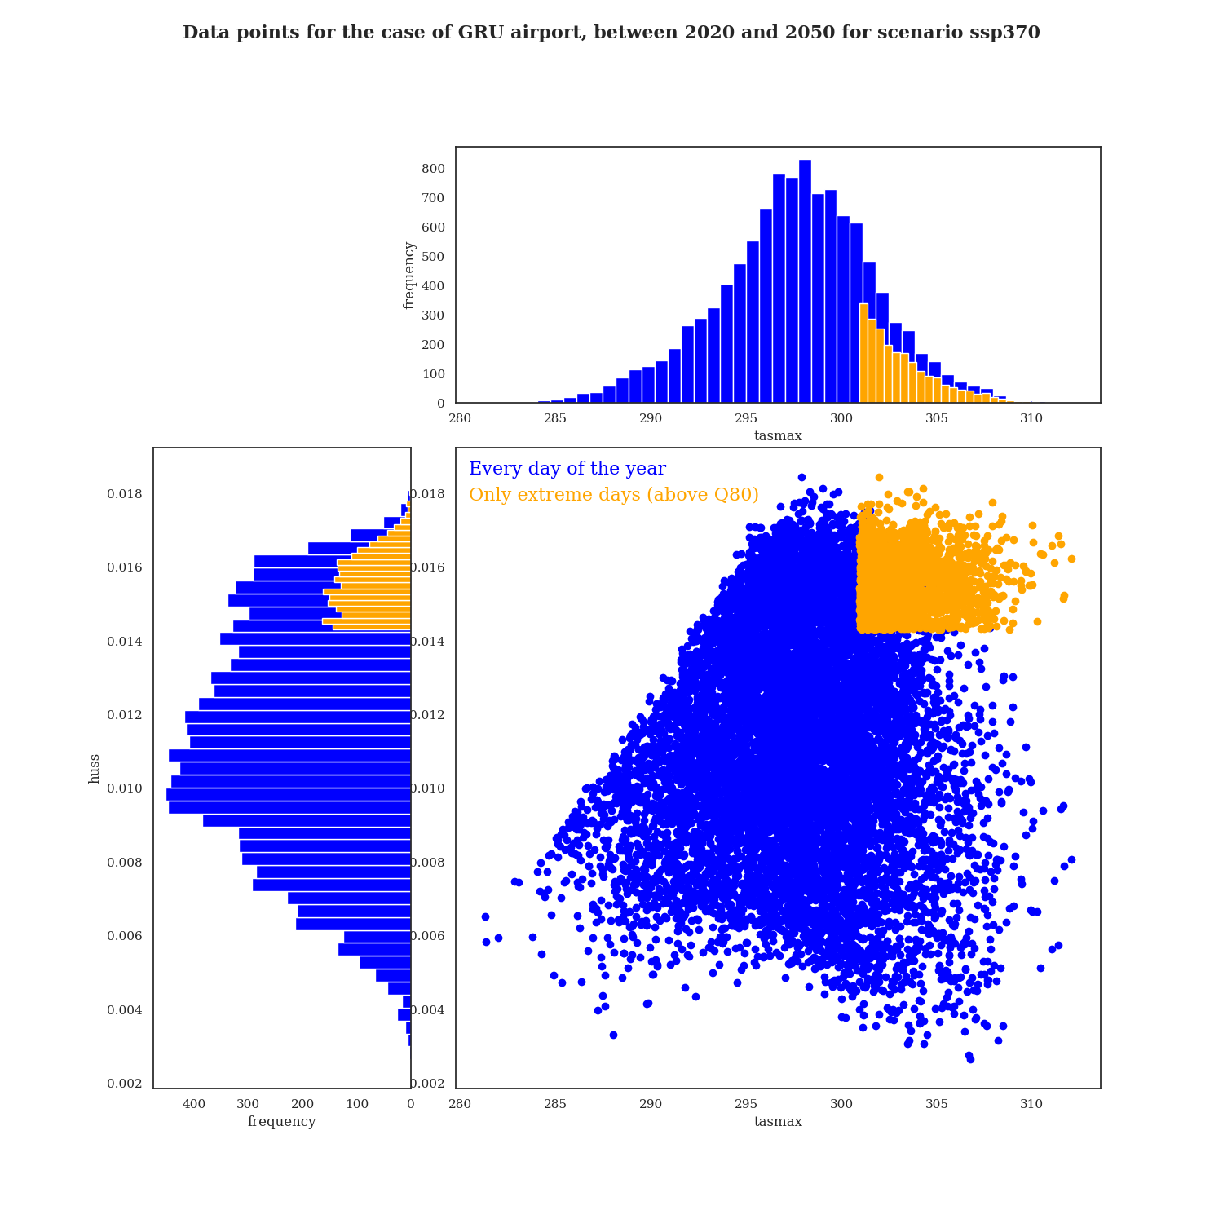
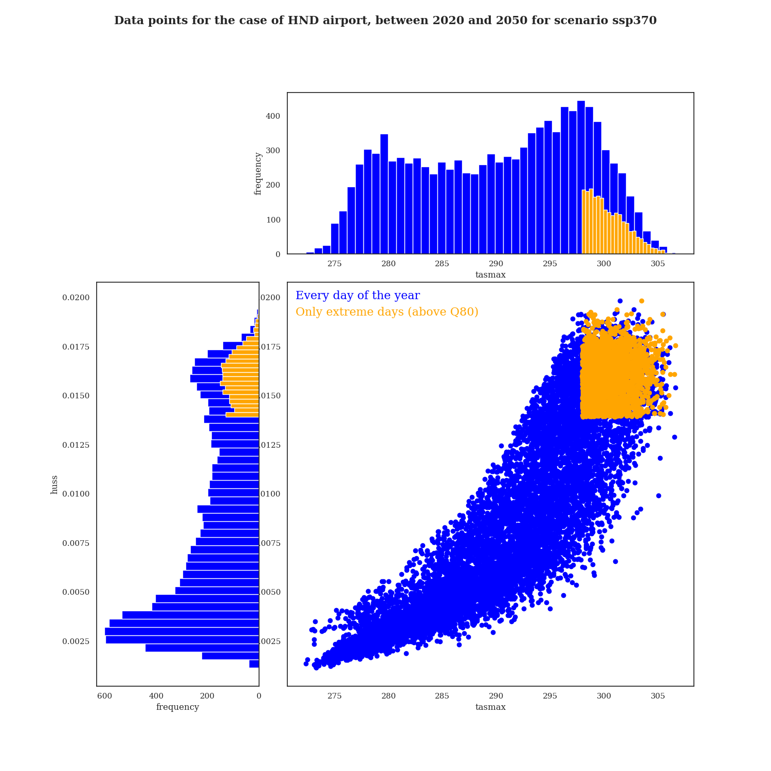
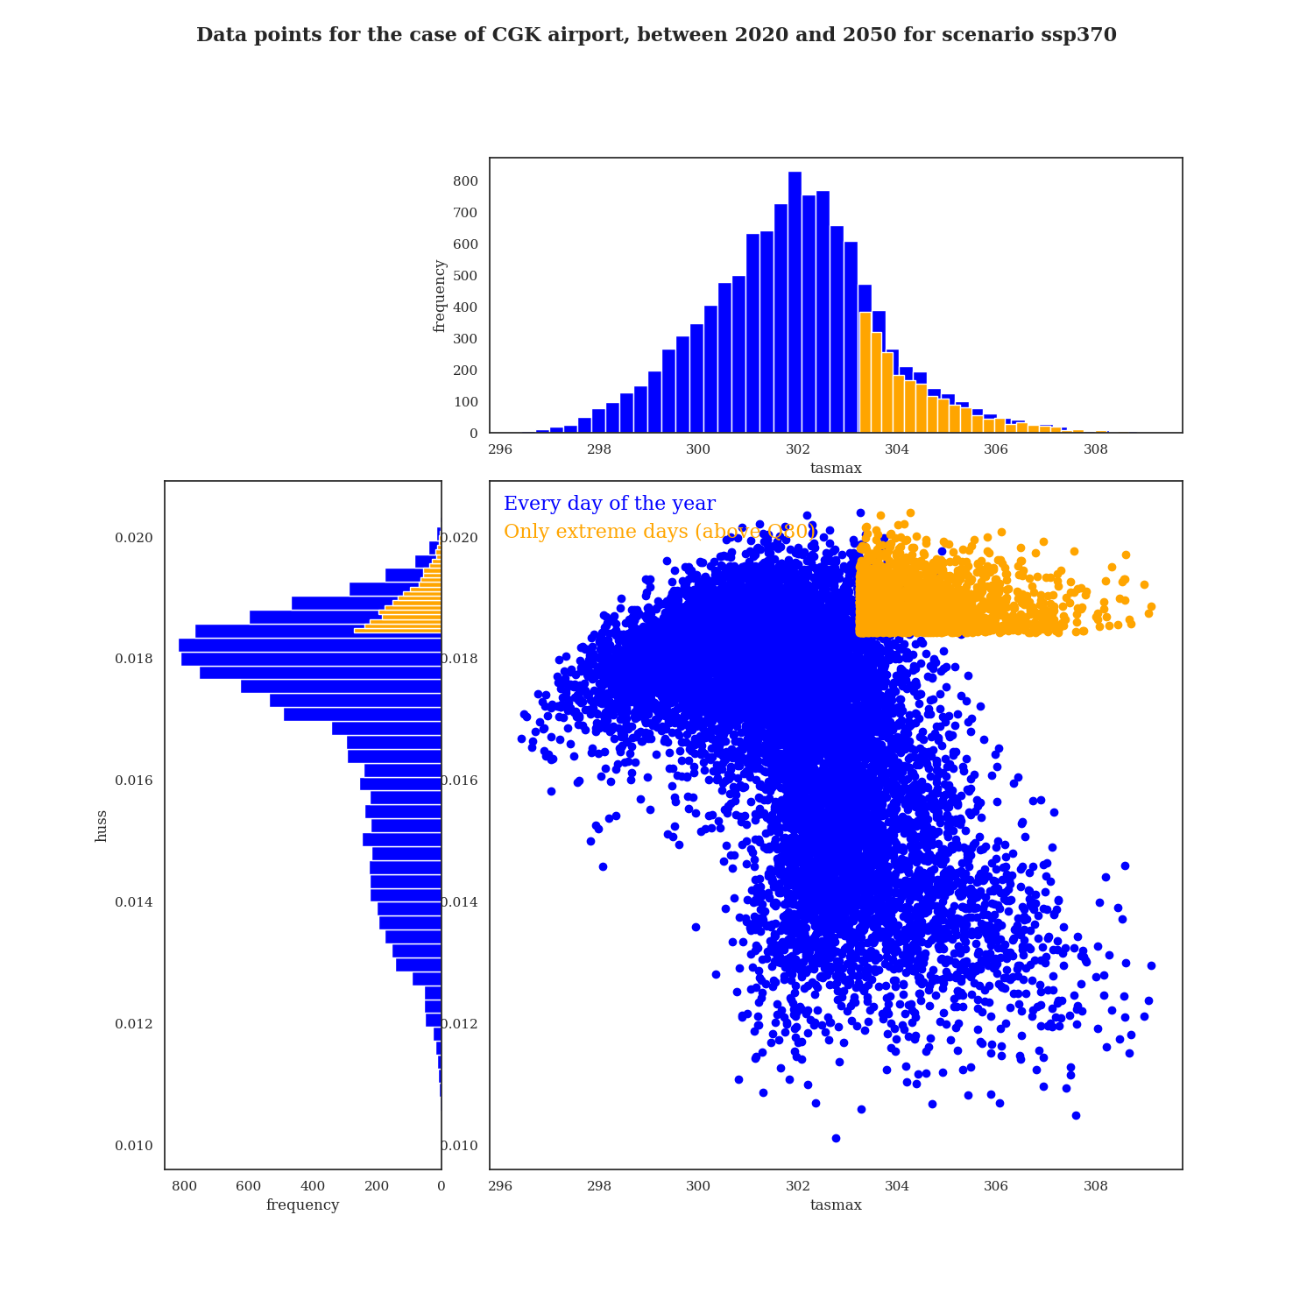
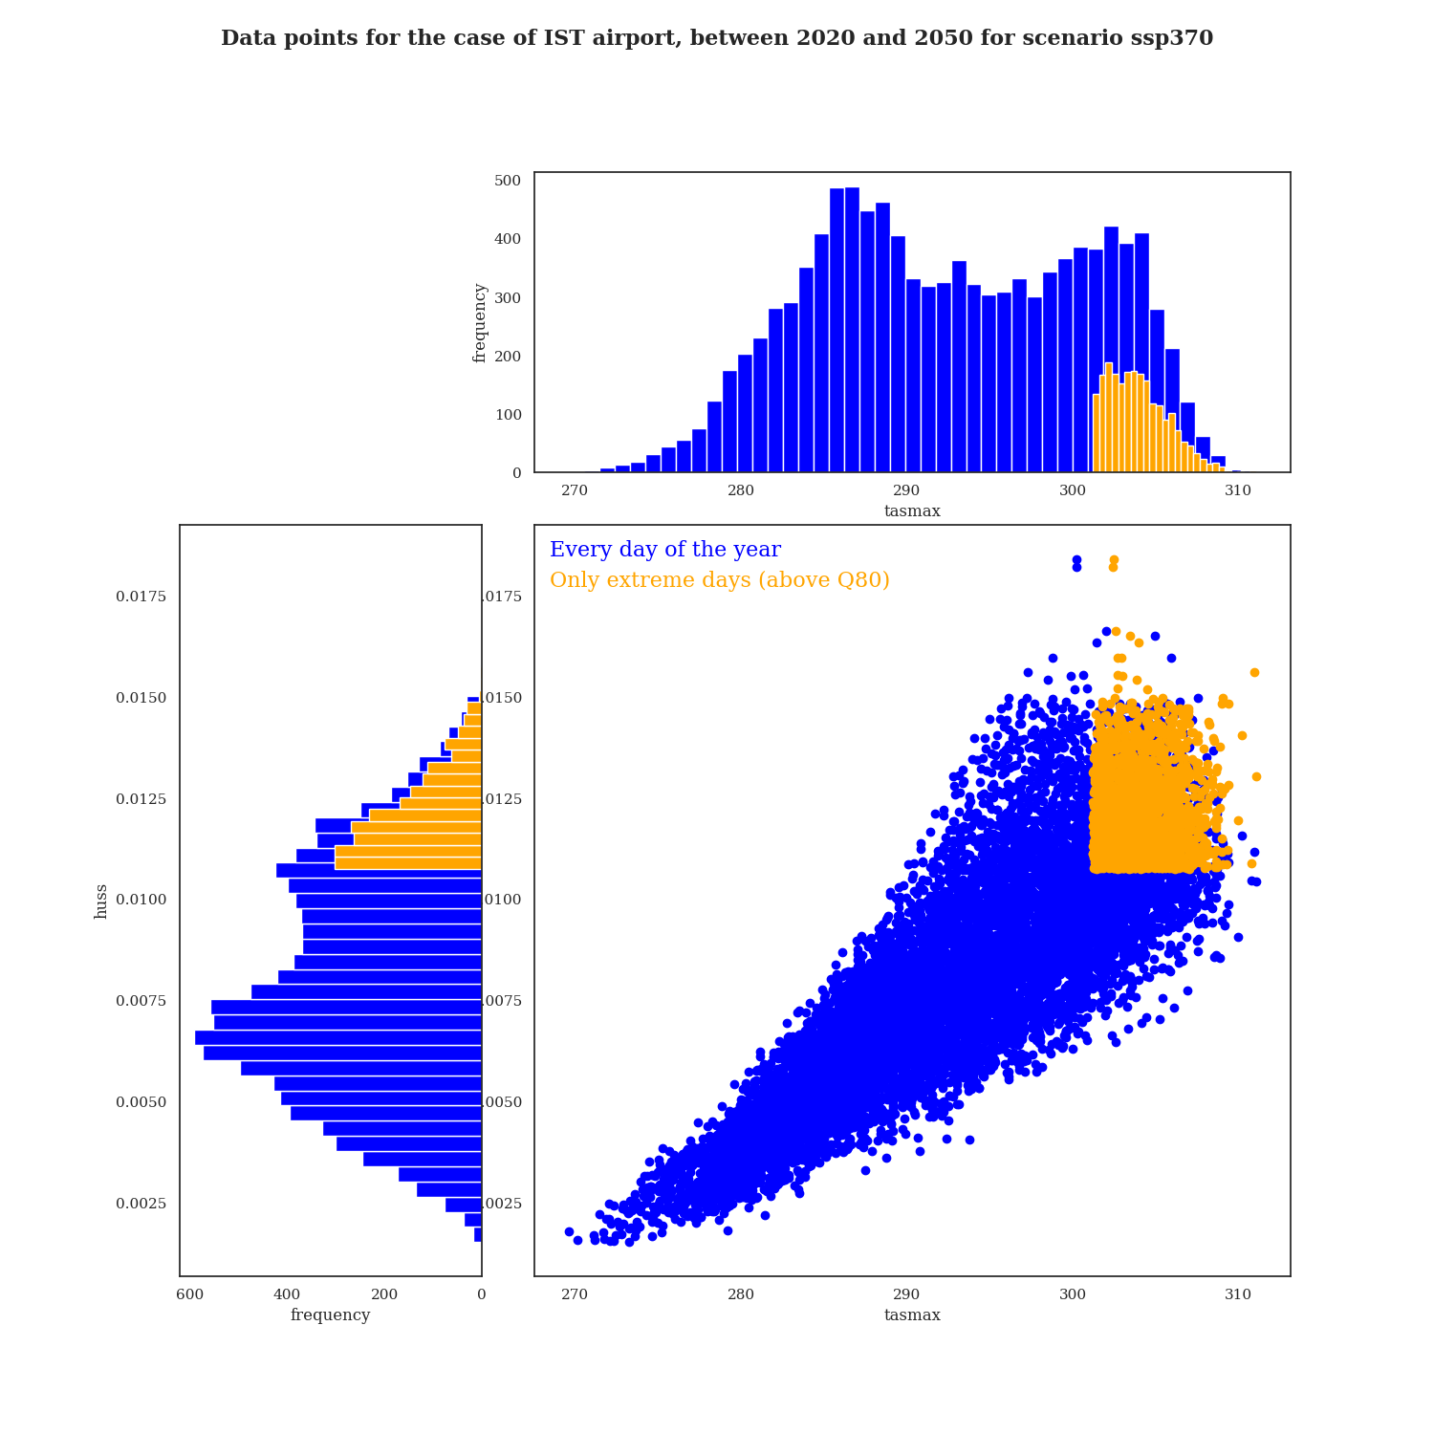
Extreme quantiles
Defining all values above 80th quantile
Extreme values
Defines as all values above the 80th percentile
Toulouse
Sao Paulo
huss
huss
Every day of the year:
10 956 points
Only extreme Q80 values:
2 192 points
tasmax
tasmax
Istanbul
IST
Tokyo
Jakarta
huss
huss
huss
tasmax
tasmax
tasmax

Slide 17
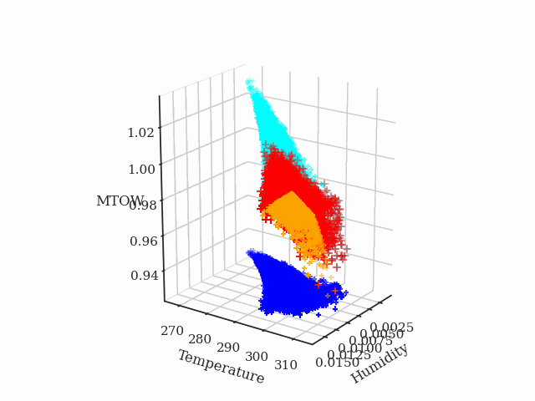
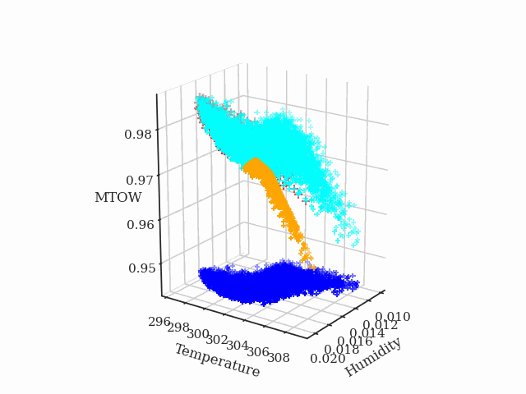
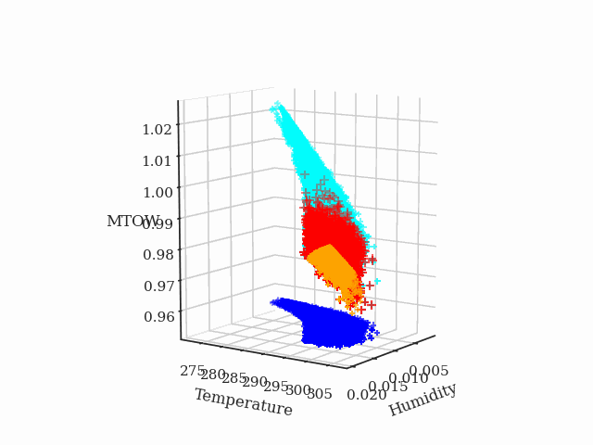
Propagation of extreme values
Toulouse
Jakarta
Tokyo
Output
MTOW
Summer
Aircraft model
Extreme Q80
Input data
tasmax
huss
Max Take-Off Weight
Notes:
Case of Jakarta: Summer = very humid but not the highest temperatures

Slide 18
Focusing on extreme values
1. Summer
2. Extreme quantiles
3. Critical threshold
Notes:
Why? Because sensitivity to normal atmospheric conditions for qhichv the performance is not too impacted doesn’t interest us

Slide 19
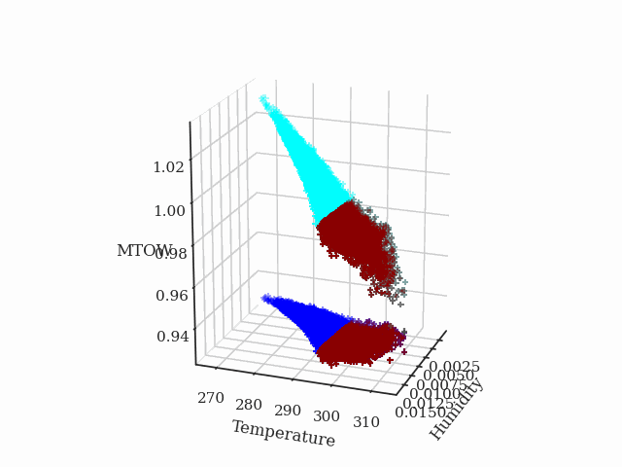
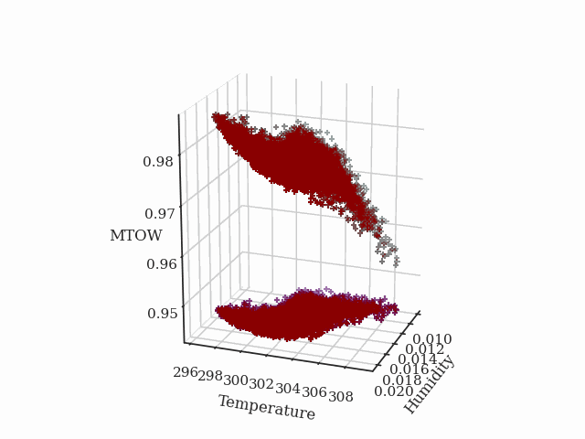
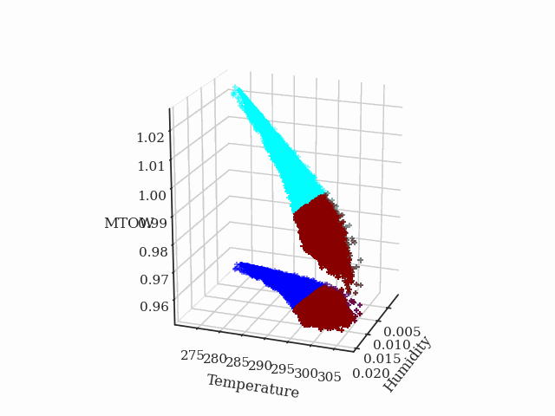
Critical MTOW threshold
Defining extreme values with an MTOW threshold
MTOW threshold
Critical domain defined for
Toulouse
Jakarta
Tokyo
Critical days
Output
MTOW
Critical threshold definition
Aircraft model
Input data
tasmax
huss
3 240 critical days
(29.6 % of days)
10 958 critical days
(100% of days)
4 400 critical days
(40.2% of days)
Focuses on all input variables that give performance defined as critical
Con: Variable number of critical data
Max Take-Off Weight

Slide 20
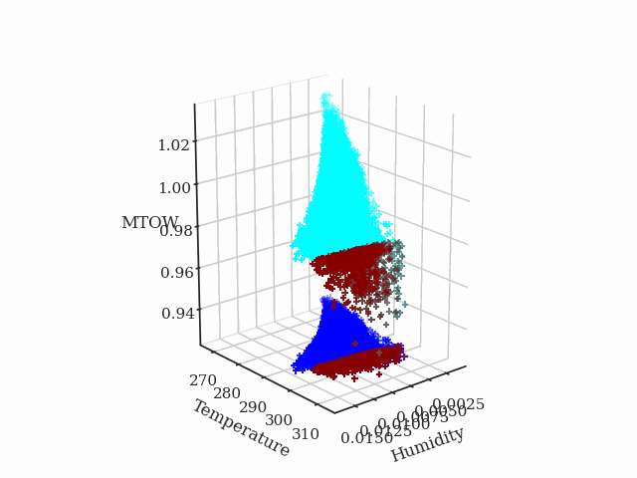
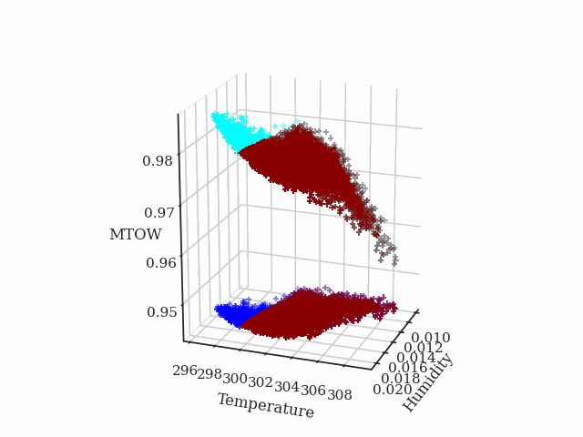
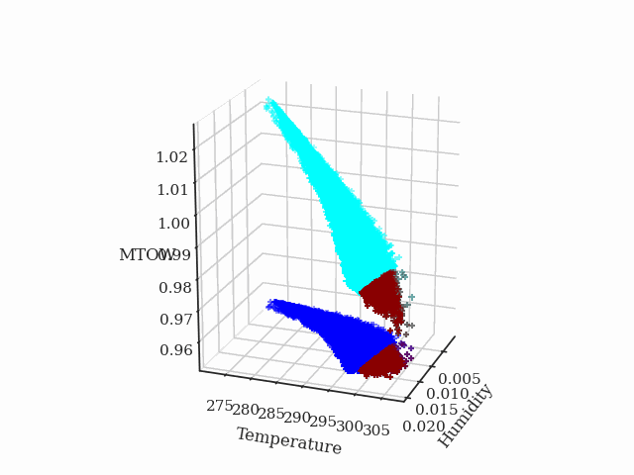
Critical MTOW threshold
Defining extreme values with an MTOW threshold
MTOW threshold
Critical domain defined for
Toulouse
Jakarta
Tokyo
Critical days
Output
MTOW
Critical threshold definition
Aircraft model
Input data
tasmax
huss
3 240 critical days
(7.7 % of days)
9 669 critical days
(88.2% of days)
993 critical days
(9.0% of days)
Focuses on all input variables that give performance defined as critical
Con: Variable number of critical data
Max Take-Off Weight

Slide 21
Fitting input distribution and sensitivity analysis
For critical data

Slide 22
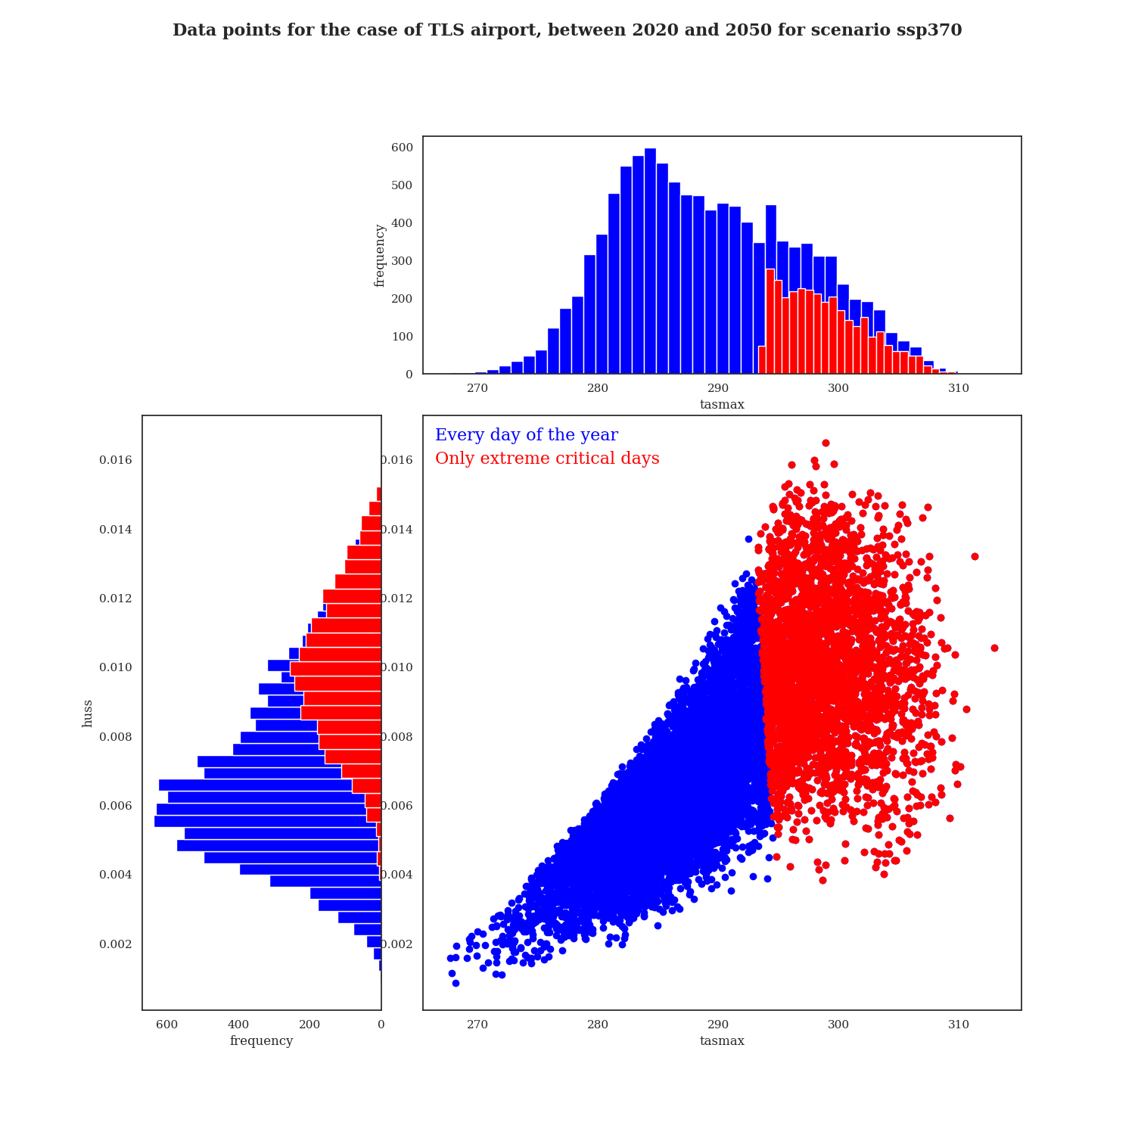
Input distribution
Toulouse
Threshold =
Every day of the year:
10 956 points
Only critical days:
3 240 points

Slide 23
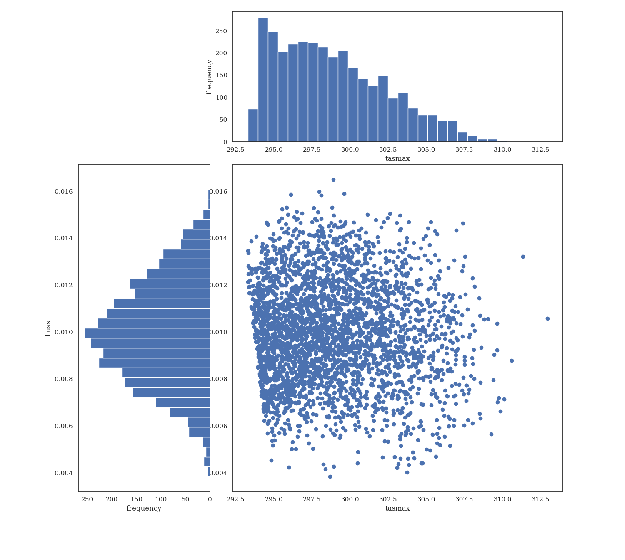
Critical input distribution
Toulouse
Threshold =
huss
tasmax

Slide 24
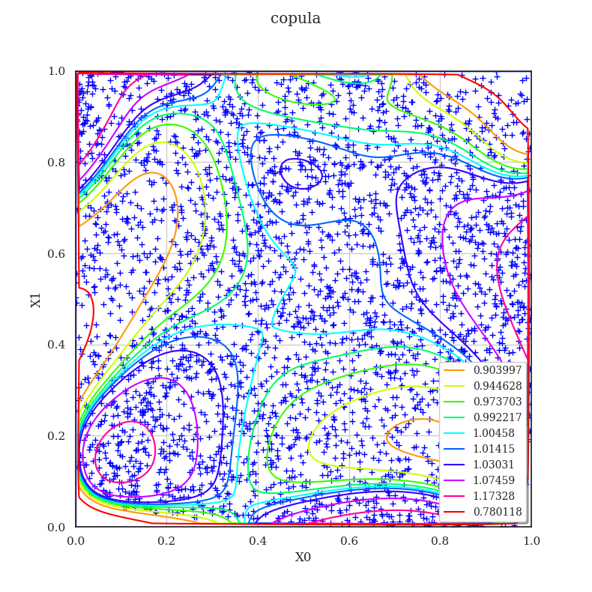
Dependency
Toulouse
Threshold =
Fitting an Empirical Bernstein Copula
+ Sample in rank space
Copula PDF contours
huss
tasmax

Slide 25
Dependency
Toulouse
Threshold =
Fitting an Empirical Bernstein Copula
+ Sample in rank space
Copula PDF contours
huss
Correlation coefficients
Pearson: -0.048
Spearman: -0.018
Difference between lowest and highest density: 0.27
tasmax

Slide 26
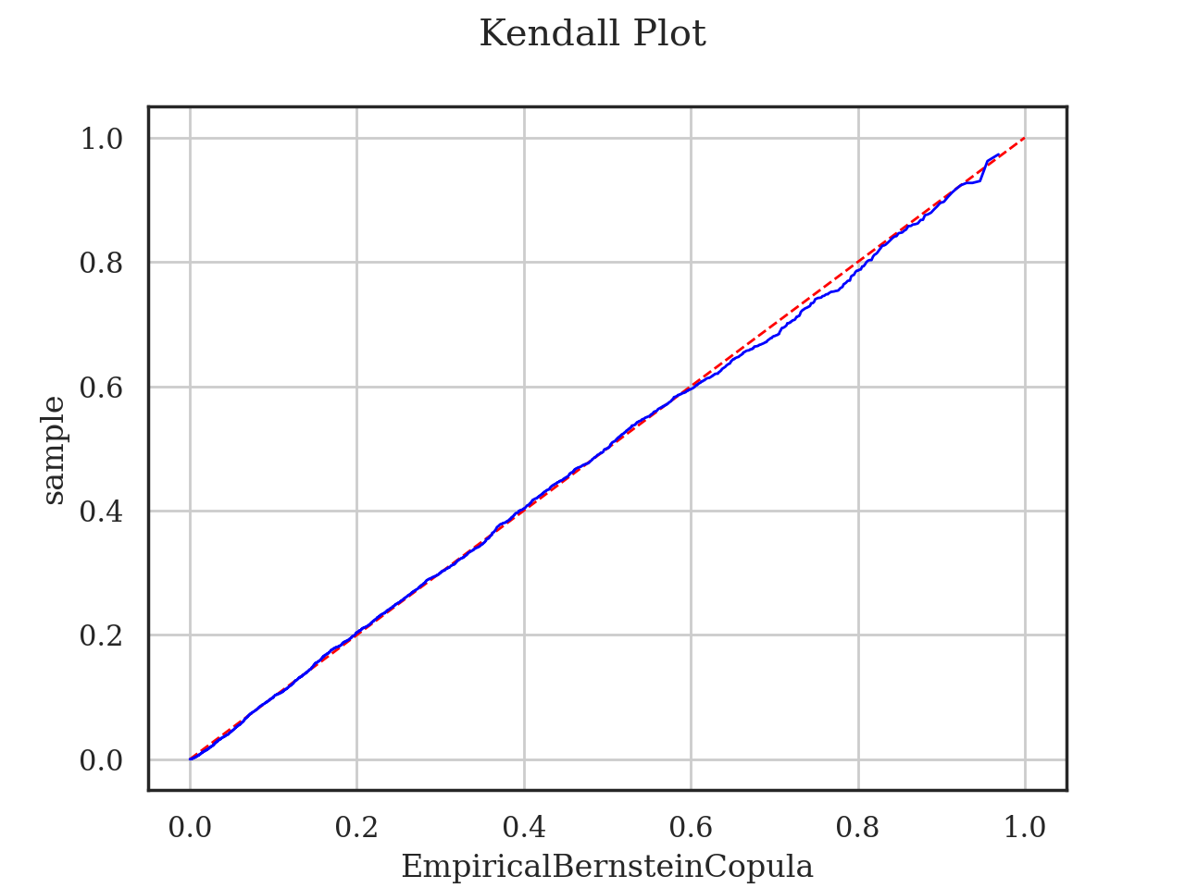
Dependency
Toulouse
Threshold =
Fitting an Empirical Bernstein Copula
+ Sample in rank space
Kendall plot
Sample
Empirical Bernstein Copula
Copula PDF contours
huss
Correlation coefficients
Pearson: -0.048
Spearman: -0.018
Difference between lowest and highest density: 0.27
tasmax

Slide 27
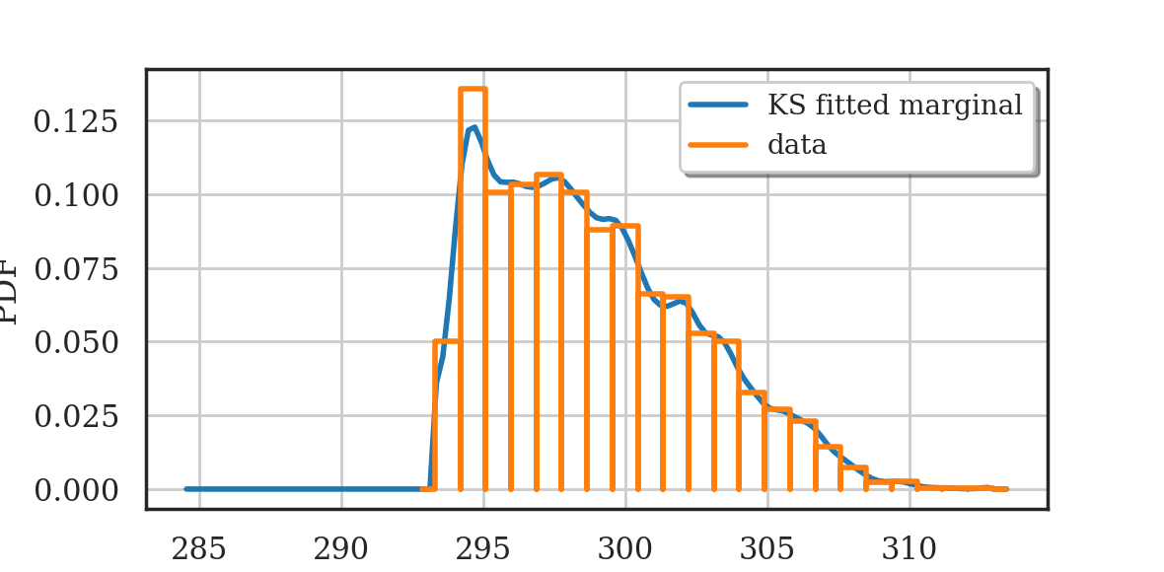
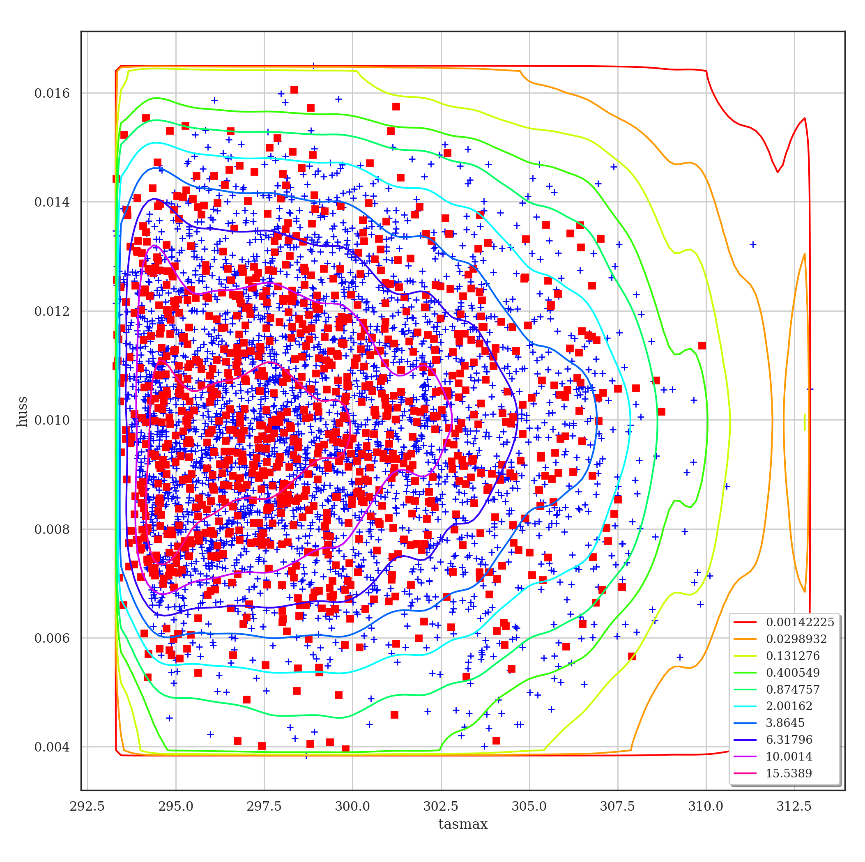
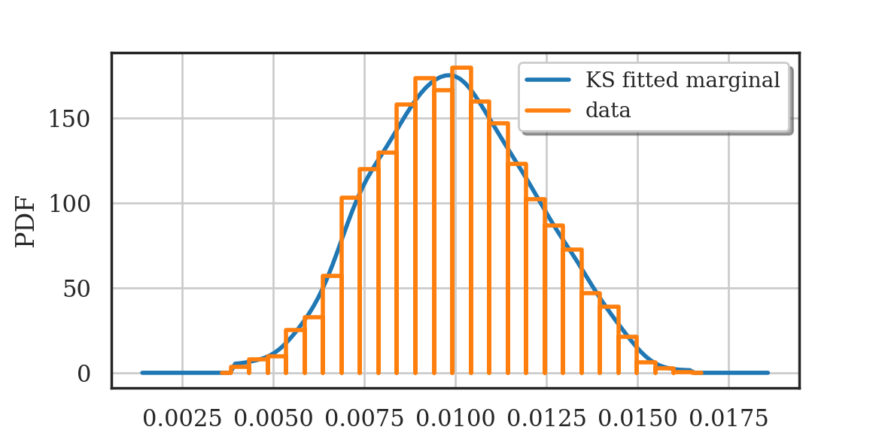
Joint composed distribution
Toulouse
Threshold =
Fitting an Empirical Bernstein Copula
+ Sample in rank space
Kendall plot
Fitted marginals with Kernel Smoothing
Sample
Empirical Bernstein Copula
Copula PDF contours
huss
Correlation coefficients
Pearson: -0.048
Spearman: -0.018
Difference between lowest and highest density: 0.27
Joint distribution contours
+ Data sample
Sample on fitted PDF
tasmax

Slide 28
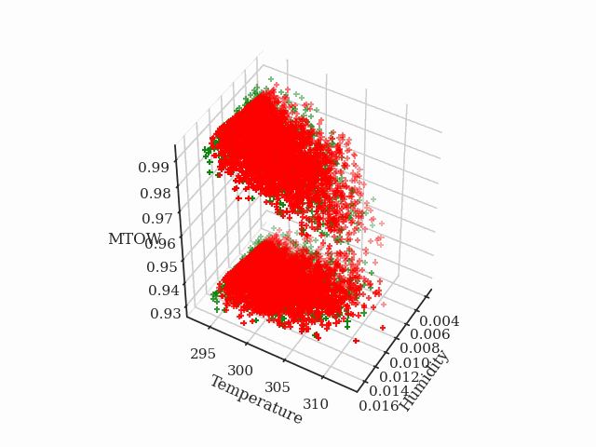
Propagated results
Toulouse
Sample of joint composed distribution
Critical propagated data
Max Take-Off Weight

Slide 29
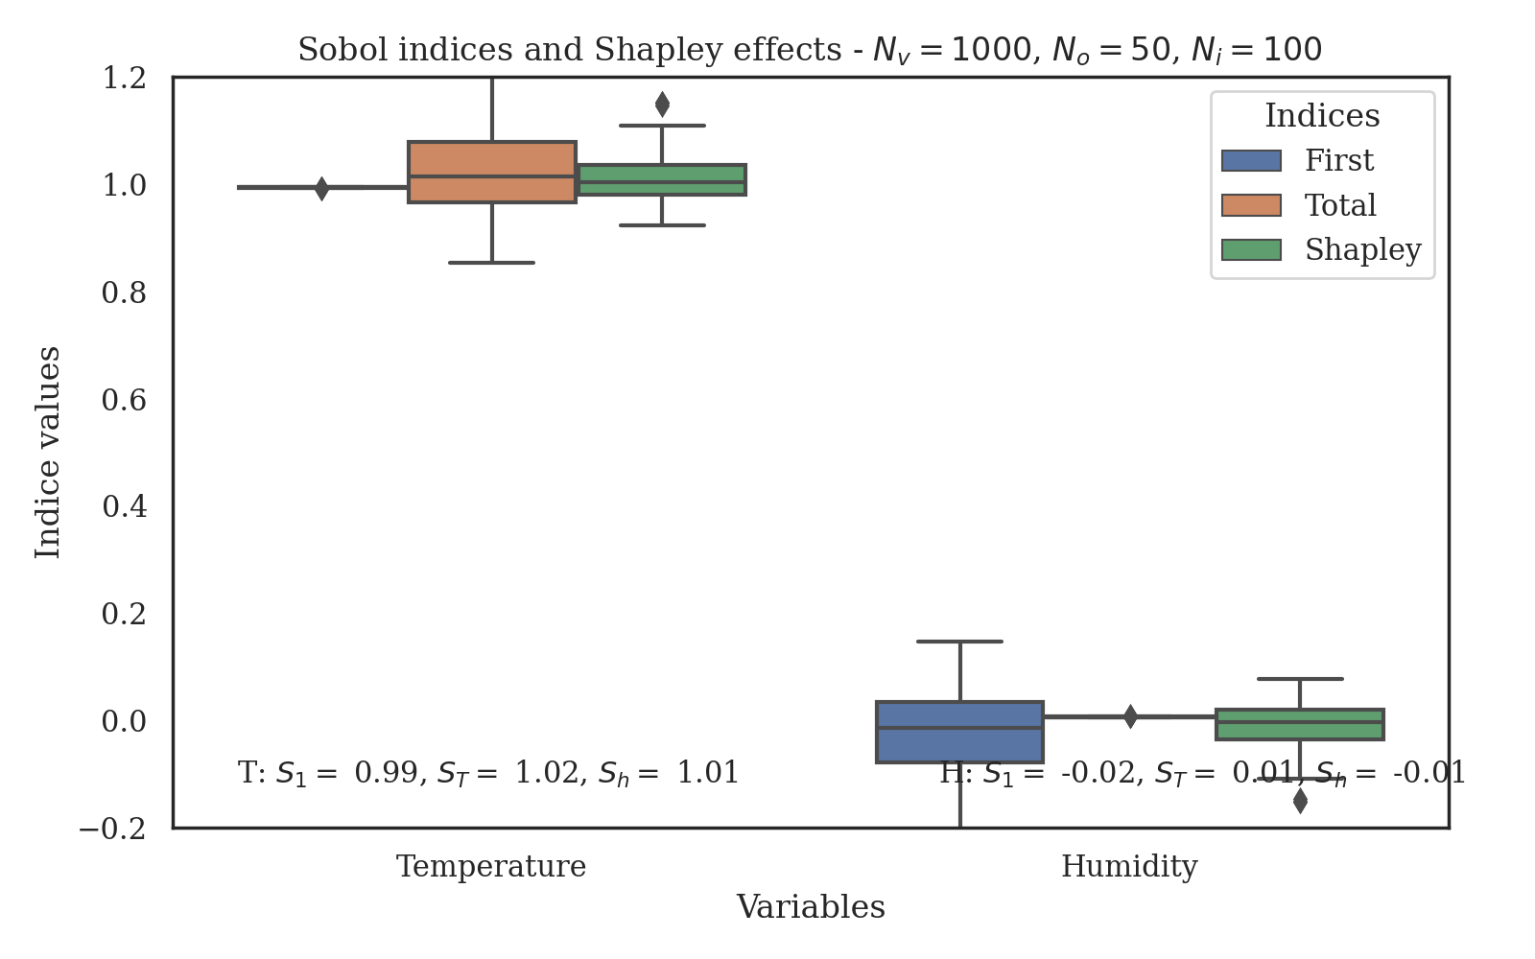
Sensitivity Analysis
Toulouse
Notes:
Sobol First indices: T: 0.99 , H: -0.0223
Sobol Total indices: T: 1.02 , H: 0.01
Shapley indices: T: 1.01 , H: -0.01

Slide 30
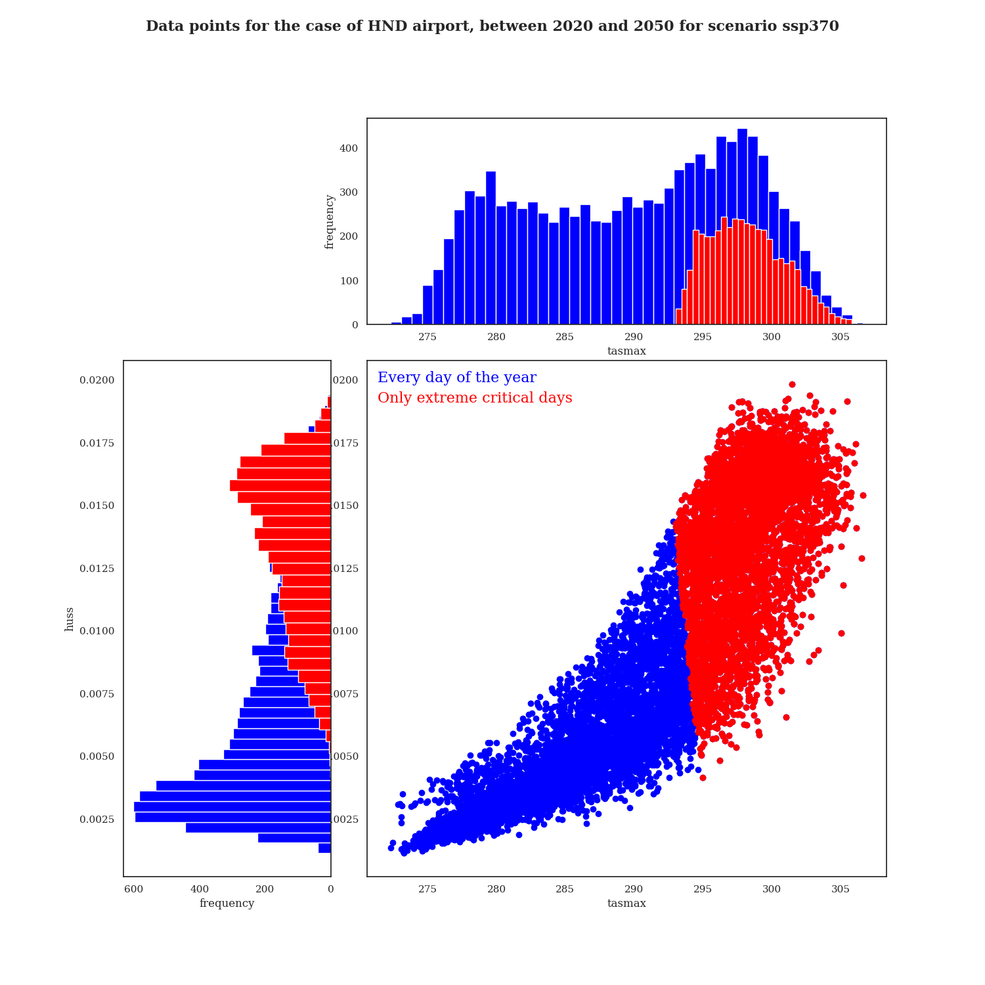
Critical input distribution
Tokyo
Threshold =

Slide 31
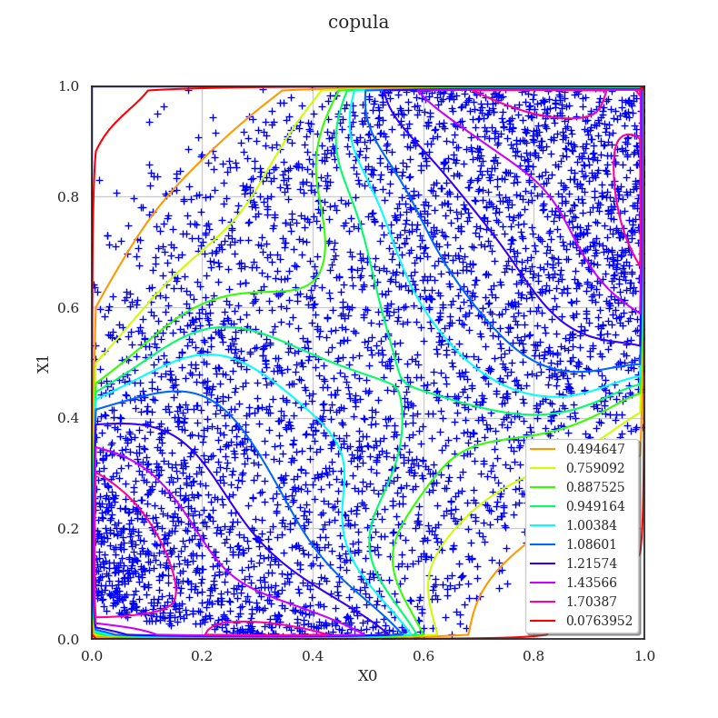

Dependency
Tokyo
Threshold =
Fitting an Empirical Bernstein Copula
+ Sample in rank space
Copula PDF
contours
Difference between lowest and highest density: 1.21
Correlation coefficients
Pearson: 0.45
Spearman: 0.47

Slide 32



Joint composed distribution
Tokyo
Threshold =
Fitting an Empirical Bernstein Copula
+ Sample in rank space
Fitted marginals with Kernel Smoothing
Copula PDF
contours
Difference between lowest and highest density: 1.21
Joint distribution
contours
Correlation coefficients
Pearson: 0.45
Spearman: 0.47
+ Data sample
Sample on fitted PDF

Slide 33

Propagated result
Tokyo
Threshold =
Sample of joint composed distribution
Critical propagated data
Max Take-Off Weight

Slide 34

Sensitivity Analysis
Tokyo
Threshold =
Notes:
Sobol First indices: T: 0.973308253584605 , H: 0.3309200036108027
Sobol Total indices: T: 0.6690799963891972 , H: 0.026691746415394988
Shapley indices: T: 0.8211941249869011 , H: 0.17880587501309889

Slide 35

Importance of dependency
Tokyo
Threshold =
With Empirical Bernstein copula
With independent copula
+ Data sample
Sample on fitted PDF
Joint distribution
contours
Joint distribution
contours
Shapley indices:
Temperature
S_{h}=0.82
S_{h}=0.94
Humidity
S_{h}=0.18
S_{h}=0.06
Notes:
With copula :
Sobol First indices: T: 0.973308253584605 , H: 0.3309200036108027
Sobol Total indices: T: 0.6690799963891972 , H: 0.026691746415394988
Shapley indices: T: 0.8211941249869011 , H: 0.17880587501309889
Without:
Sobol First indices: T: 0.9646729544032492 , H: 0.07730379639689959
Sobol Total indices: T: 0.9226962036031005 , H: 0.03532704559675088
Shapley indices: T: 0.9436845790031748 , H: 0.05631542099682523

Slide 36
Why focus on extreme values?

Slide 37
All days vs. critical days
Toulouse TLS

Slide 38


All days vs. critical days
Toulouse TLS
All year
+ Sample in rank space
Critical days
+ Sample in rank space
Correlation coefficients
Pearson: 0.77
Spearman: 0.81
Correlation coefficients:
Pearson : -0.048
Spearman : -0.018
Notes:
Autant, on a une forte correlation quand on regarde les données sur toute l’année (ce qui résulte en une sensibilité non négligeable par rapport à l’humidité)
Autant, si on ne regarde que les jours critiques, la correlation est très faible (ce qui se traduit par le fait que la temperature soit la seule responsible de la variabilité de la sortie)

Slide 39
All days vs. critical days
Toulouse TLS
All year
+ Sample in rank space
Critical days
+ Sample in rank space
Correlation coefficients
Pearson: 0.77
Spearman: 0.81
Correlation coefficients:
Pearson : -0.048
Spearman : -0.018
Dependency structure very different
→ Impacts sensitivity results
Notes:
Autant, on a une forte correlation quand on regarde les données sur toute l’année (ce qui résulte en une sensibilité non négligeable par rapport à l’humidité)
Autant, si on ne regarde que les jours critiques, la correlation est très faible (ce qui se traduit par le fait que la temperature soit la seule responsible de la variabilité de la sortie)

Slide 40
Conclusion and perspectives

Slide 41
Conclusion
High temperature and humidity have a negative effect on performance
Sensitivity of MTOW: Temperature predominant in its elementary influence but humidity also has a non negligeable influence in case of dependency
Methodology put into place in order to add more input variables and outputs
Other atmospheric variables: wind components, precipitation…
Parameters of the aircraft: compression ratios, efficiencies in engine…

Slide 42
Thank you for your attention
Special thanks to
Regis Lebrun for theoretical support
Joseph Muré for help with the ot.shapley package

Slide 43
Some references
[1] V. Grewe, A. Gangoli Rao, T. Grönstedt, and et al., 2021. Evaluating the climate impact of aviation emission scenarios towards the paris agreement including covid-19 effects. Nature Communication, 12(3841 )
[2] E. Coffel and R. Horton, 2015. Climate Change and the Impact of Extreme Temperatures on Aviation, Weather, Climate, and Society, 7(1):94-102 [3] Élodie Roux, 2005. Pour une approche analytique de la dynamique du vol. Phd Thesis (Ecole Nationale Supérieure de l’Aéronautique et de l’Espace, Toulouse).
[4] A Voldoire, D Saint-Martin, and S Sénési, 2019. Evaluation of CMIP6 DECK experiments with CNRM- CM6-1. 11:2177–2213.
[5] IPCC, 2021: Climate change 2021: The physical science basis. contribution of working group i to the sixth assessment report of the intergovernmental panel on climate change. Technical report, Cambridge Univer- sity Press. In Press.
[6] Baudin, Michaël & Lebrun, Régis & Iooss, Bertrand & Popelin, Anne-Laure., 2015. OpenTURNS: An Industrial Software for Uncertainty Quantification in Simulation. 10.1007/978-3-319-11259-6_64-1.
[7] Sancetta, Alessio & Satchell, Stephen, 2004. The Bernstein copula and its applications to modeling and approximations of multivariate distributions. Econometric Theory. 2004. 20. 535-562. 10.1017/S026646660420305X.

